Slide 1


Slide 2
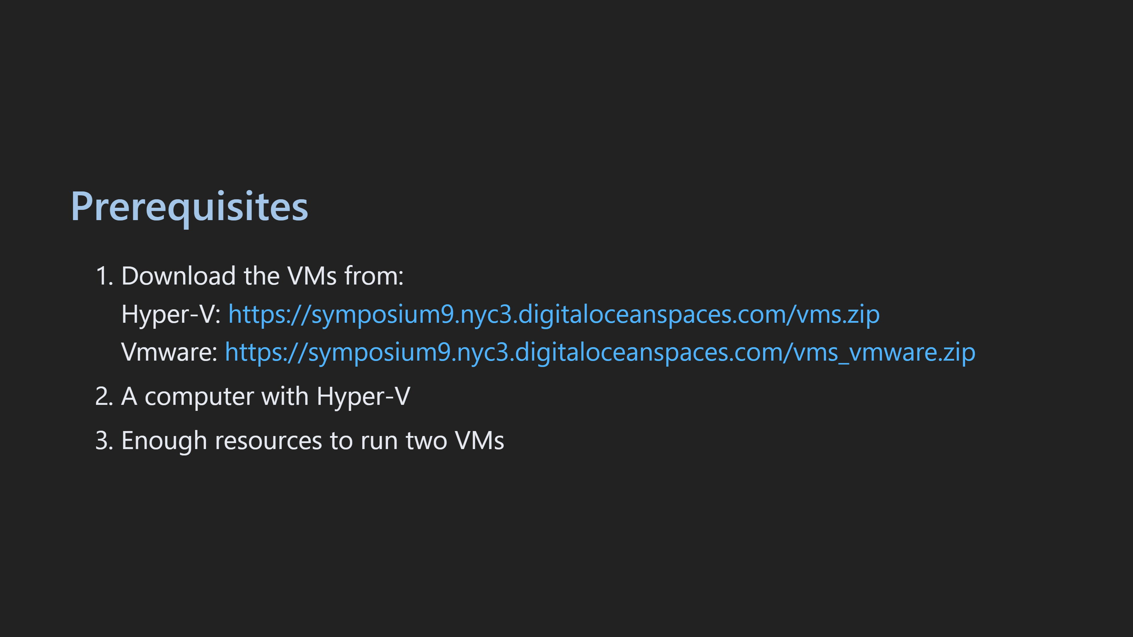

Slide 3
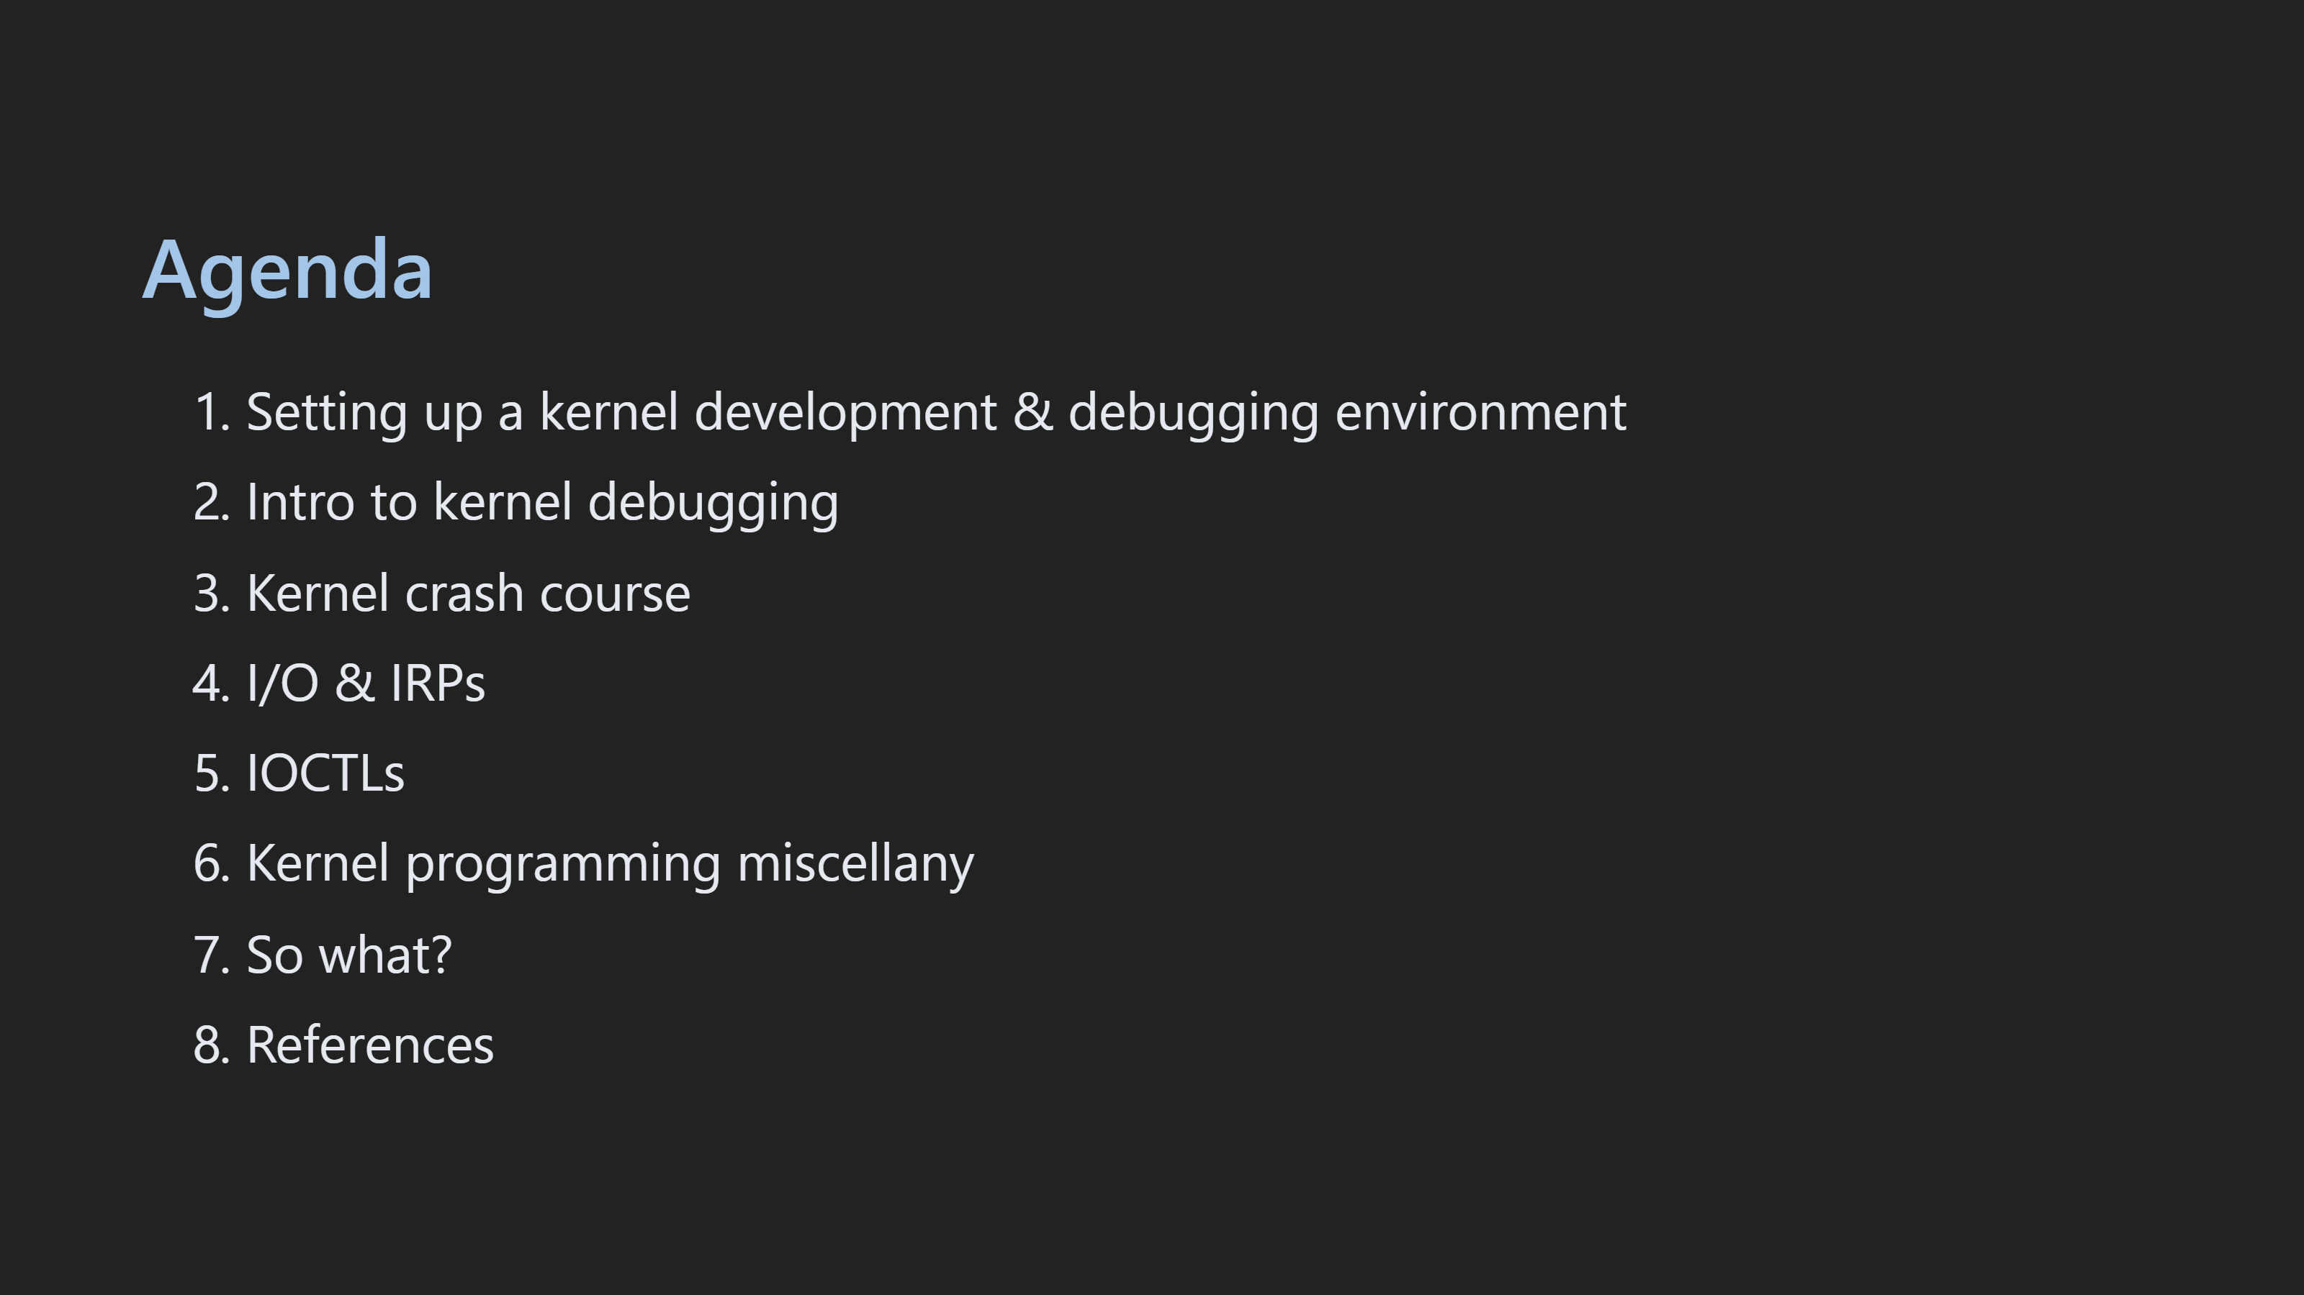
Notes:
- Talk about why we are doing kernel dev for the symposium

Slide 4
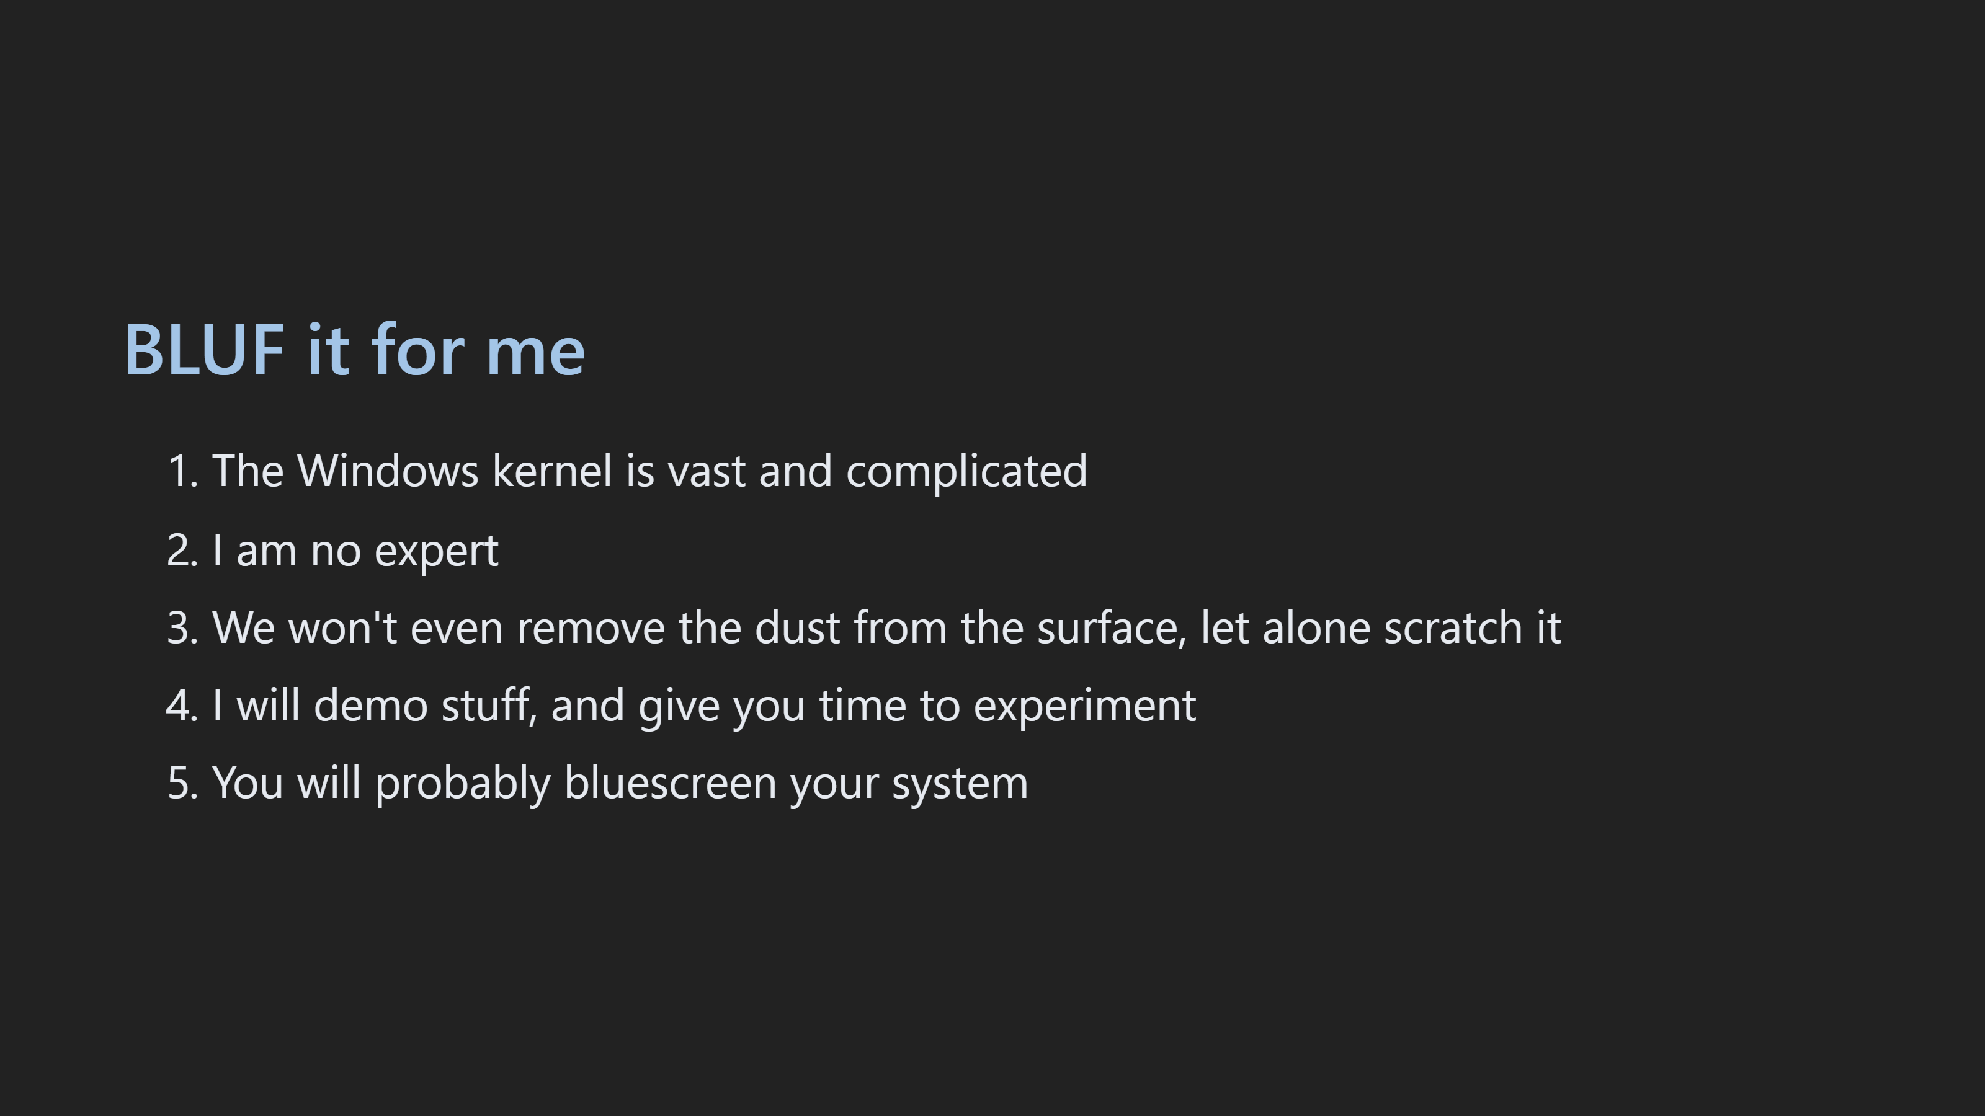

Slide 5
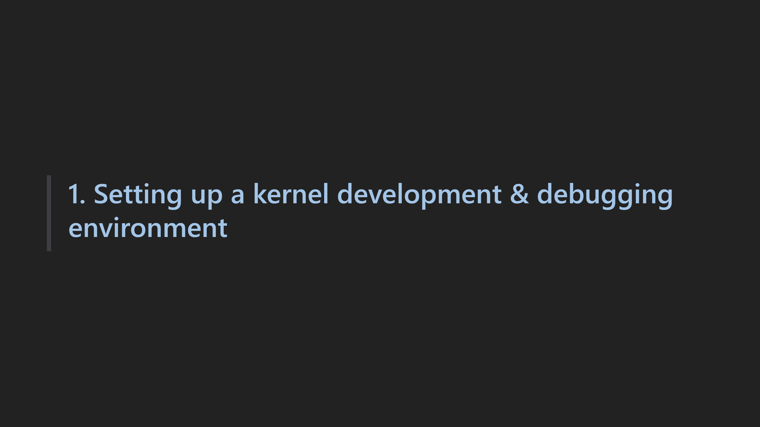

Slide 6
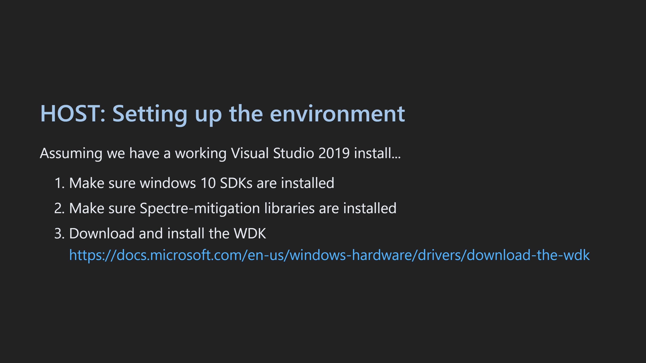

Slide 7
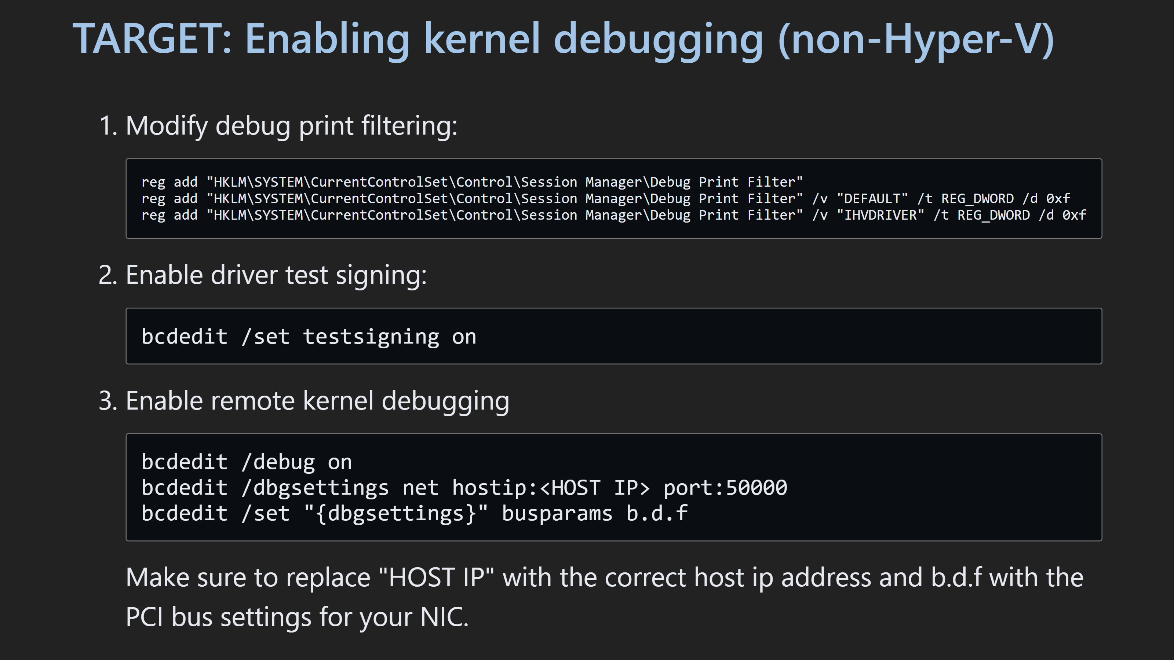

Slide 8
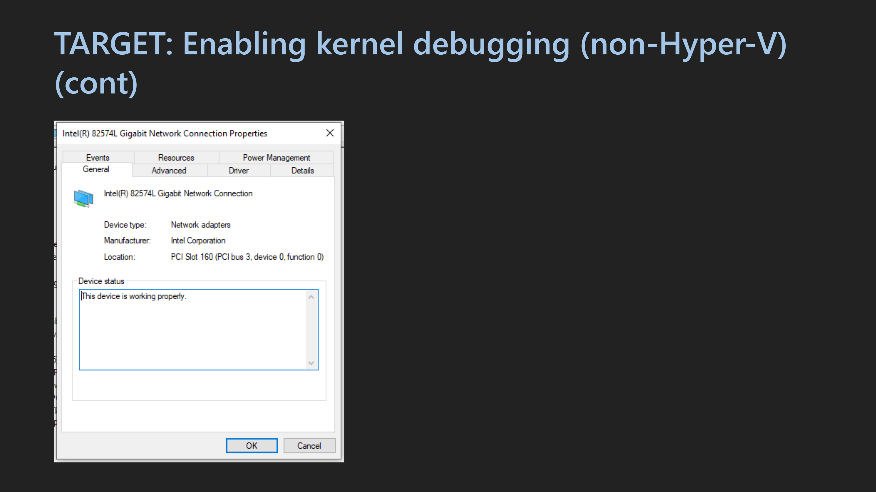

Slide 9
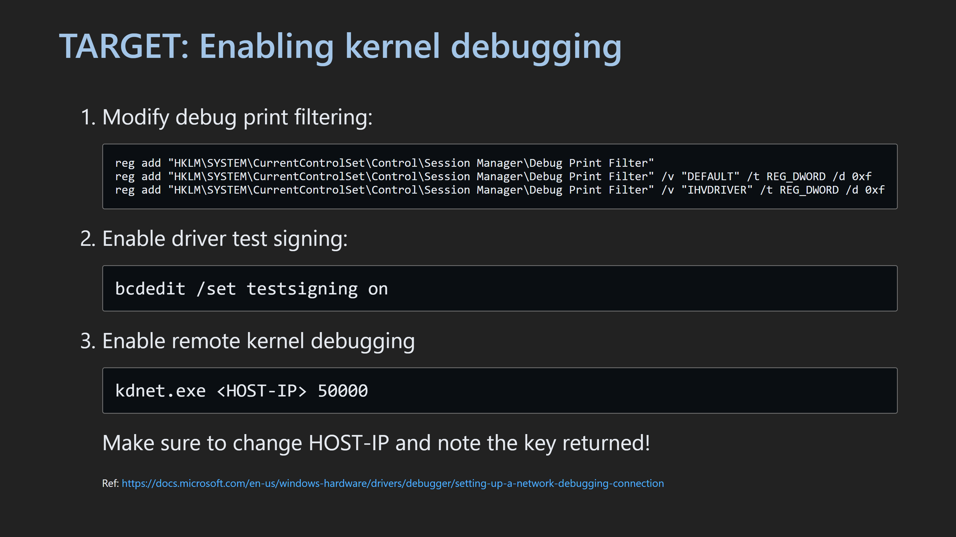

Slide 10
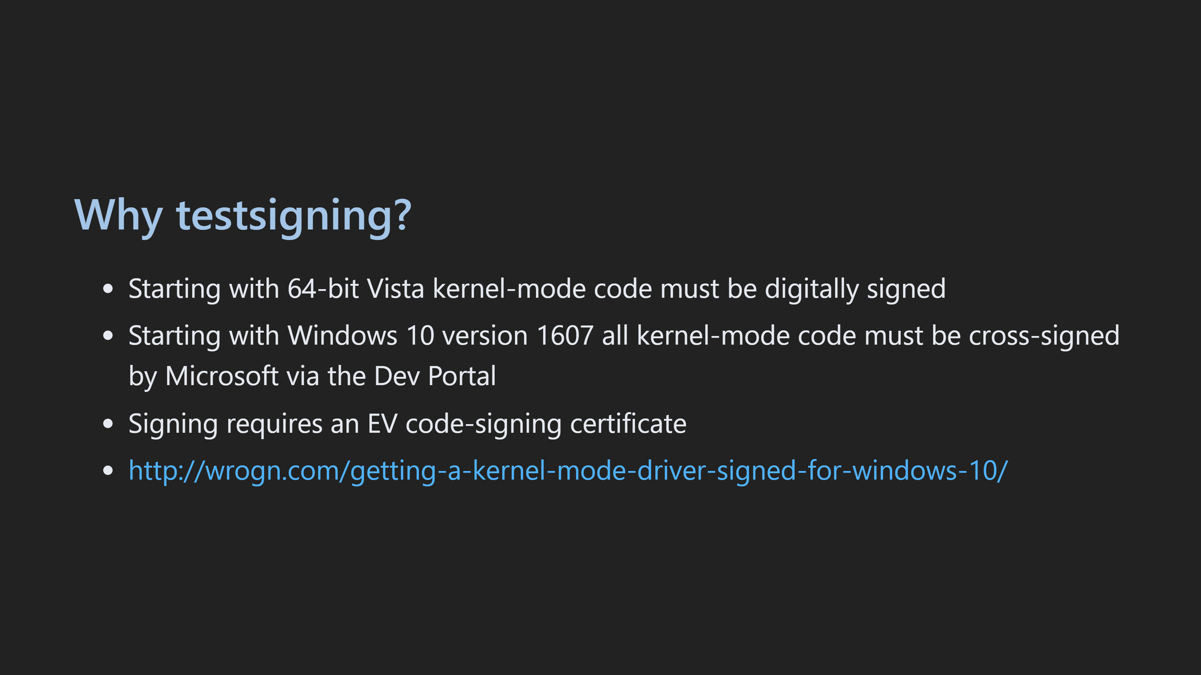

Slide 11
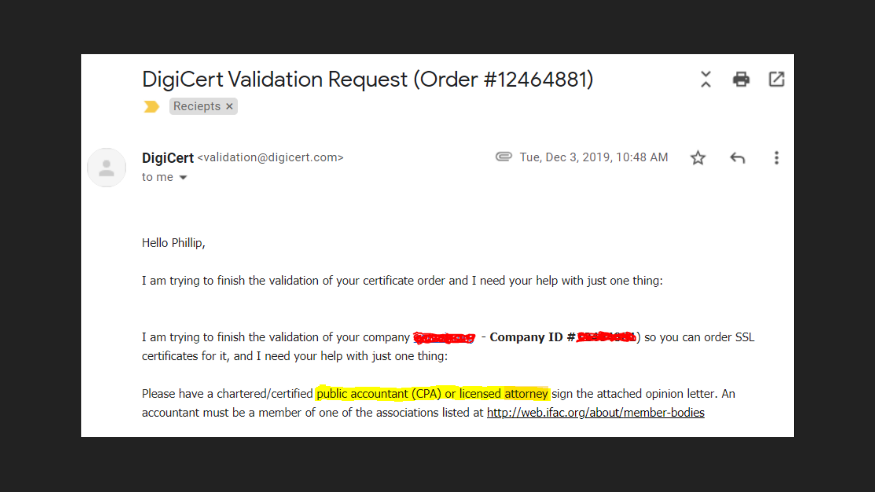

Slide 12
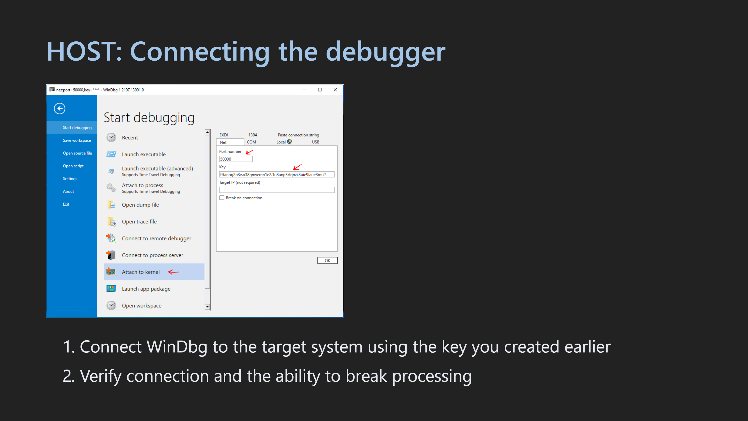

Slide 13
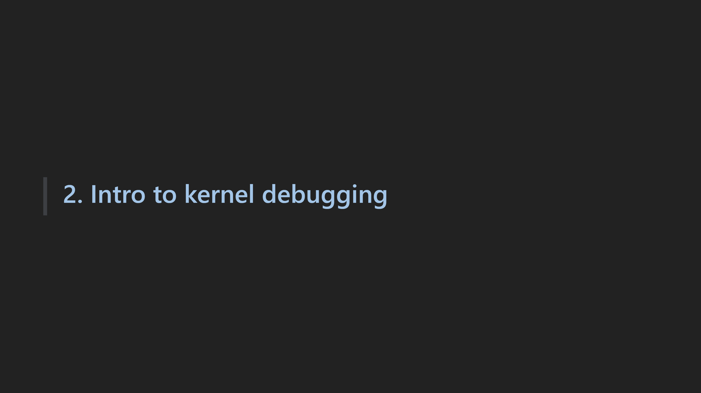

Slide 14
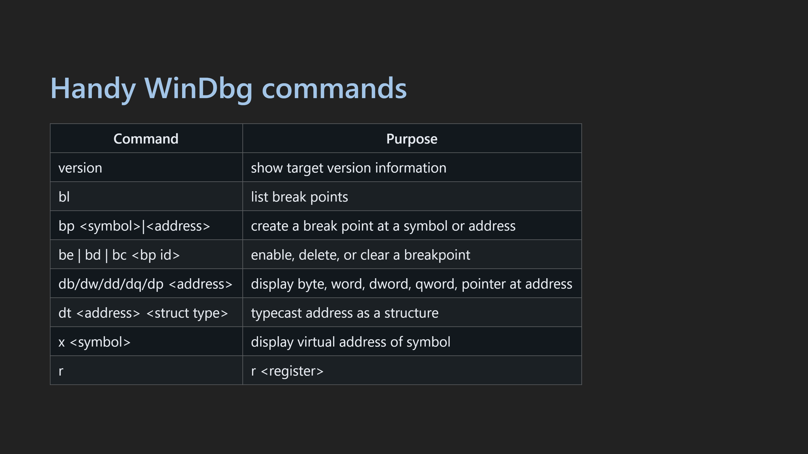

Slide 15

Notes:
.hh <command> // dd nt!KdDebuggerNotPresent L1 // symbols .sympath // breakpoints bp <addr> bc <addr> clear bd <addr> disable be <addr> enable // dd display data ds display string // dt display type dt nt!_EPROCESS // find dt x nt!ntbuil* // registers r rax // memory ranges dd nt!MmHighestUserAddress dd nt!MmSystemRangeStart // processes !process 0 0 dt nt!_EPROCESS <addr> !peb <addr> (doesn't work) .process /r /p <EPROCESS> (to get symbols) eb <byte addr> <val> (edit byte) // ntdll uf ntdll!NtClose uf kernel32!CreateFileA // walking processes ? nt!PsActiveProcessHead dt nt!_LIST_ENTRY <addr> !process <link addr>-0x448 (sub active process link) // debugger object model // misc lm <- list modules .cls <- clear screen s -sa nt!NtCreateFile L100 <- find strings .tlist <- get process list // context !process 0 0 lsass.exe <- get process info .process /r /p <addr> <- switch context to a process .process /r /p 0 <- return to kernel !dlls <- get dlls in the current context !object <addr>

Slide 16
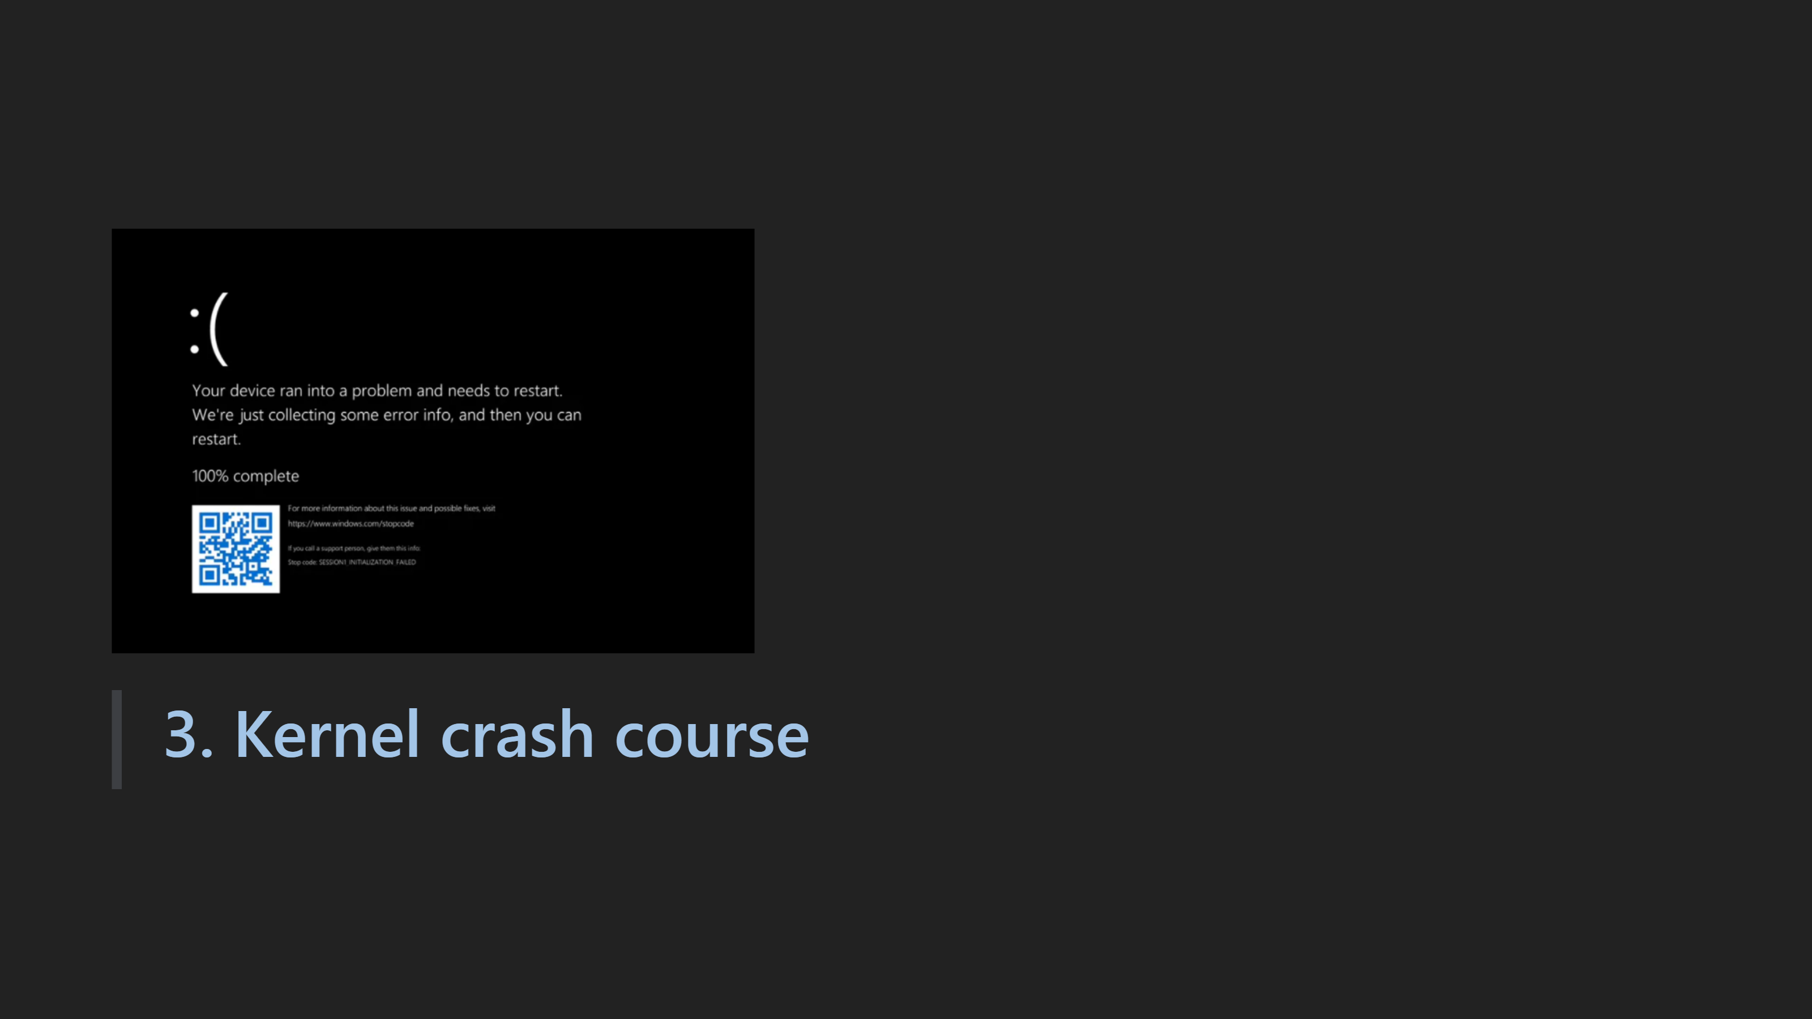

Slide 17
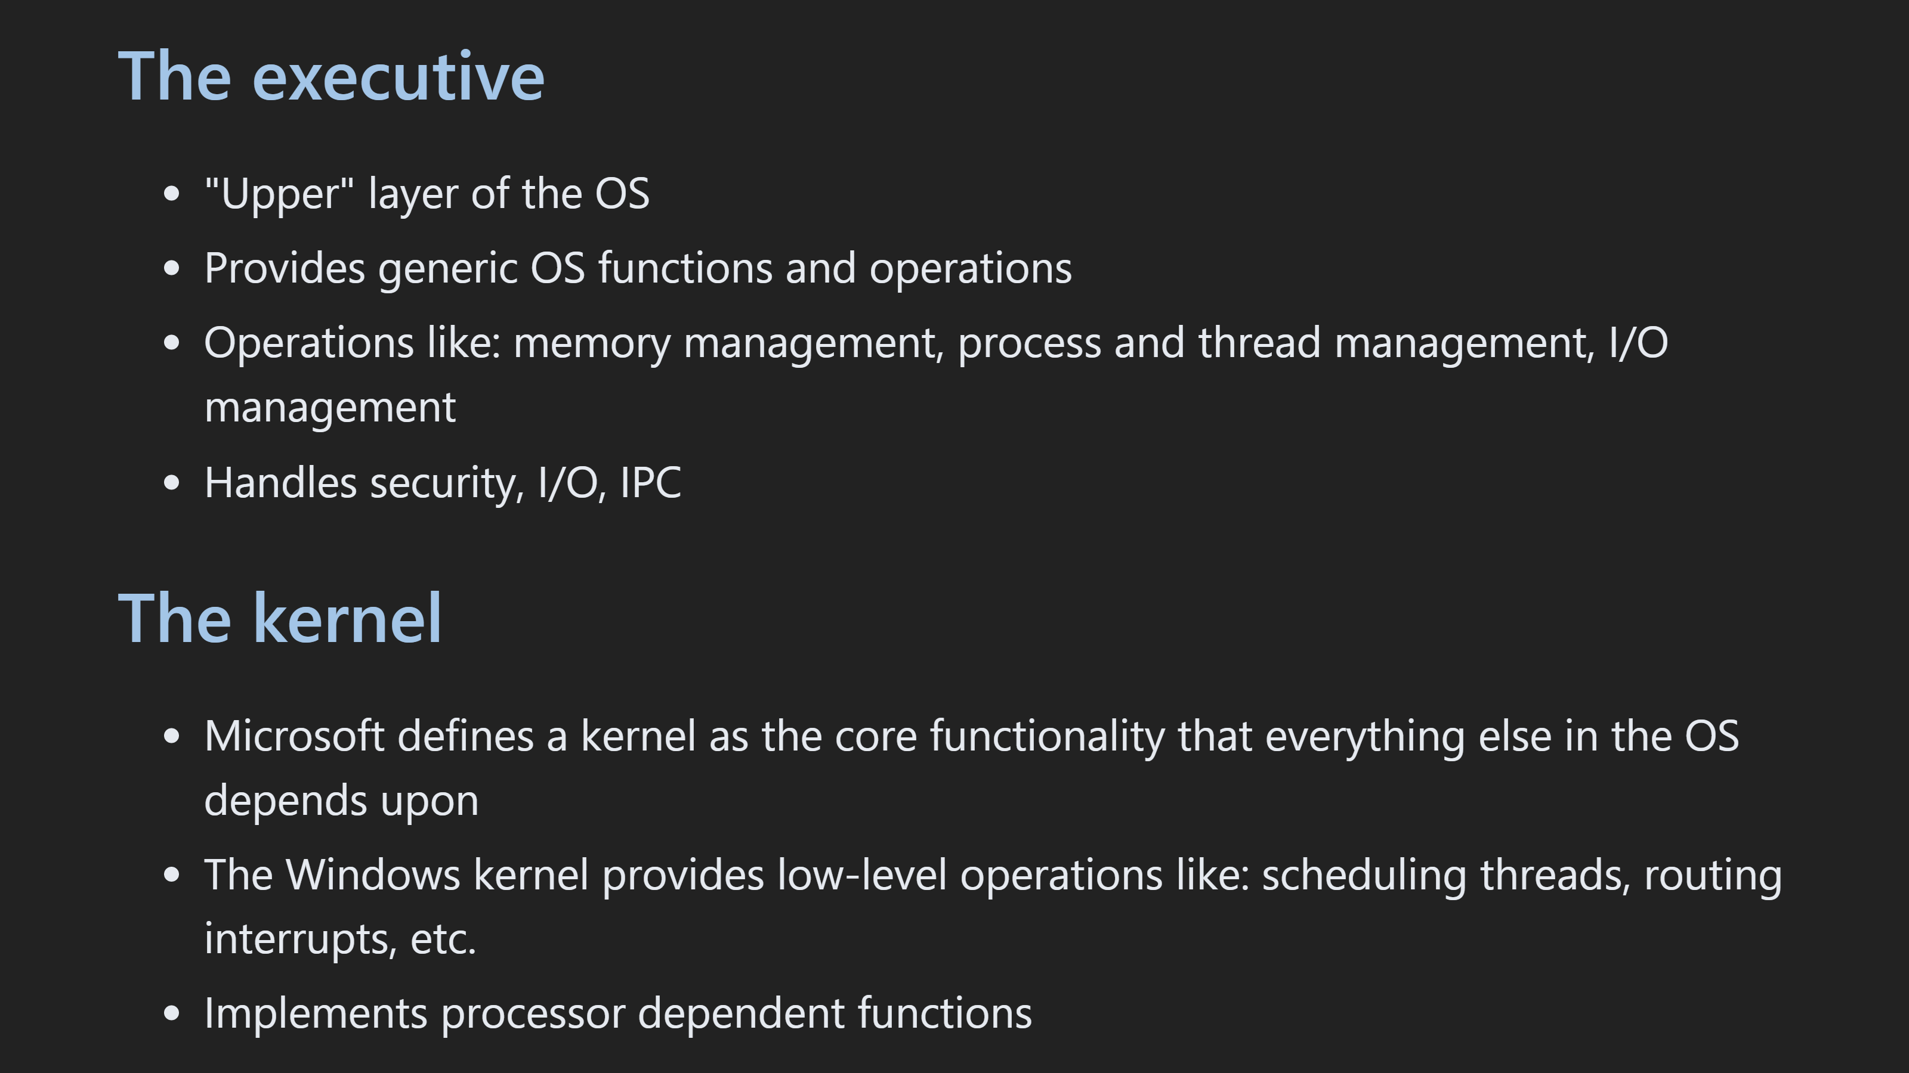

Slide 18
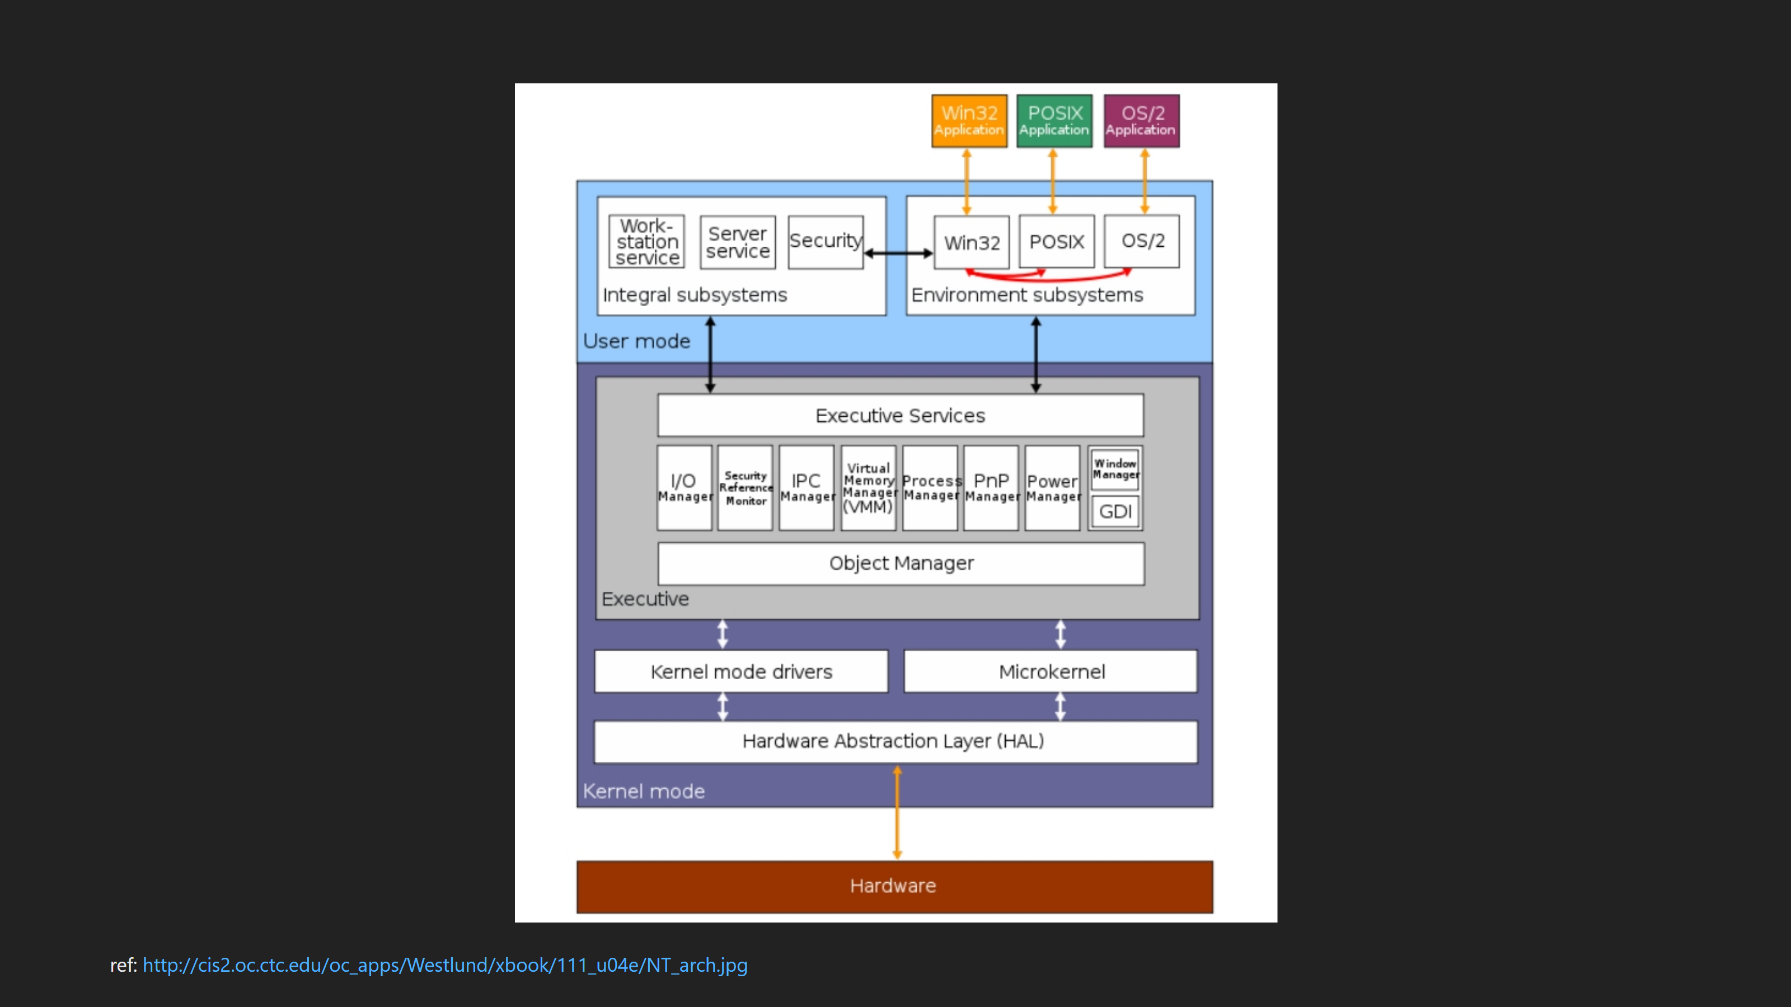

Slide 19
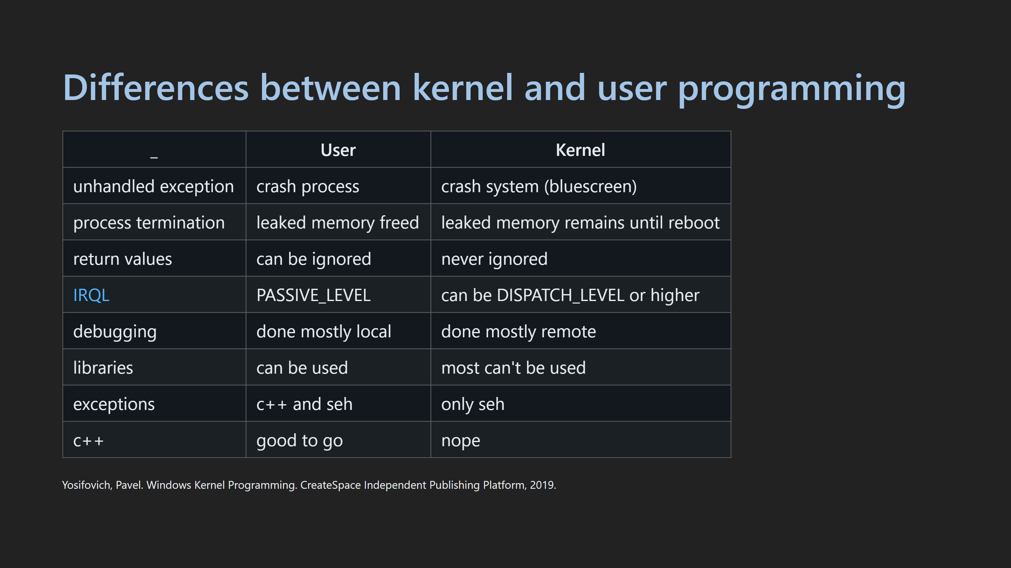

Slide 20
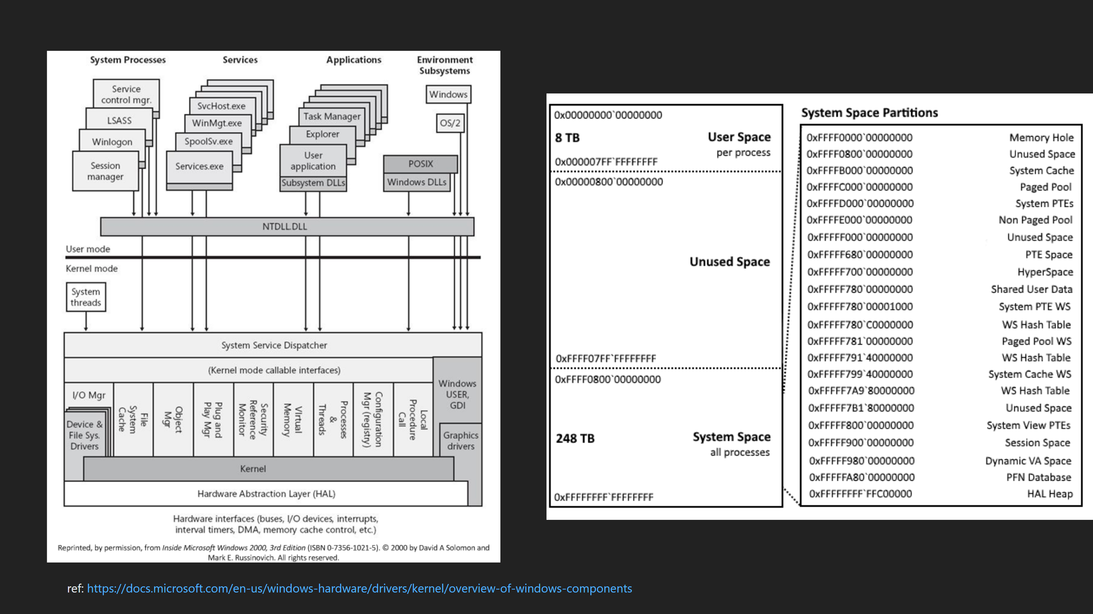
Notes:
Windows components

Slide 21
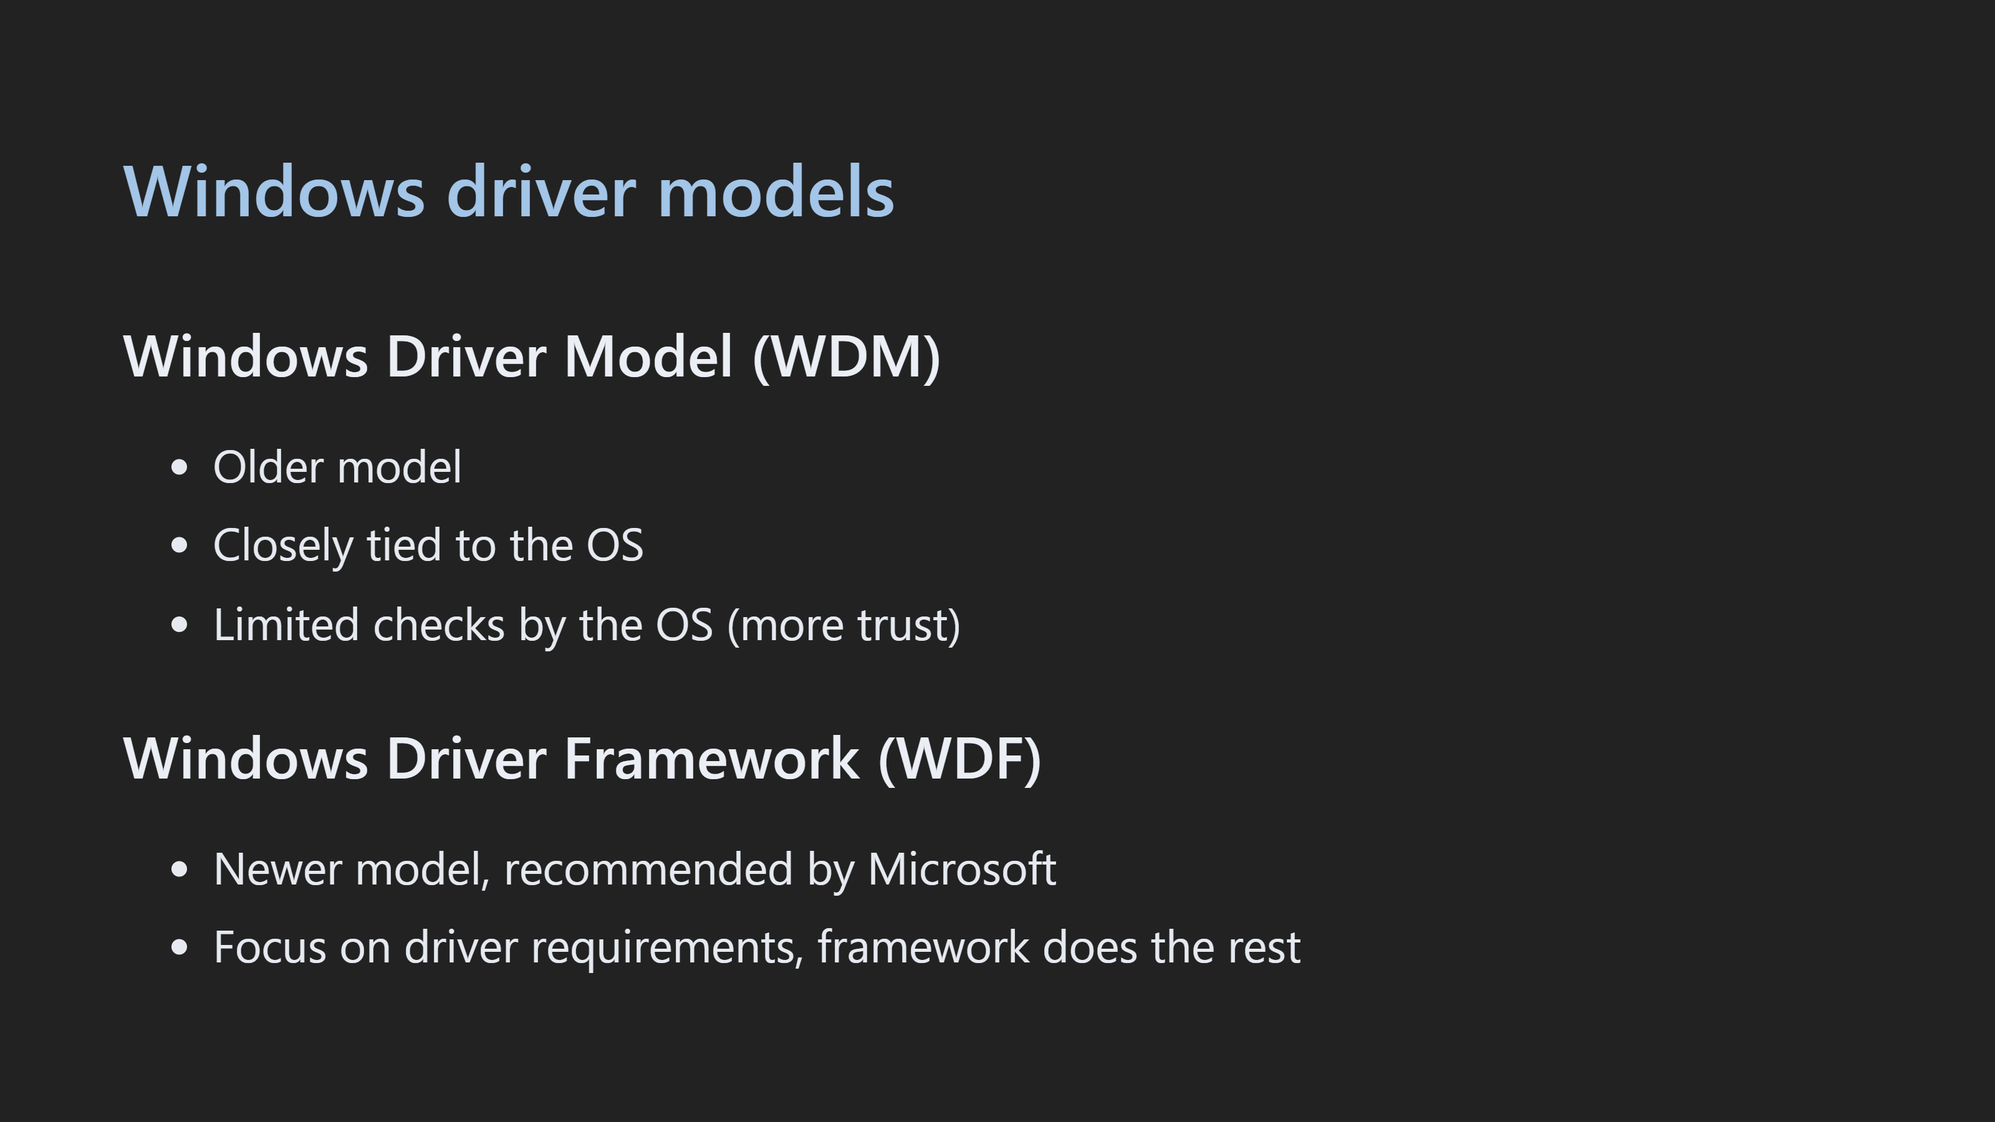

Slide 22
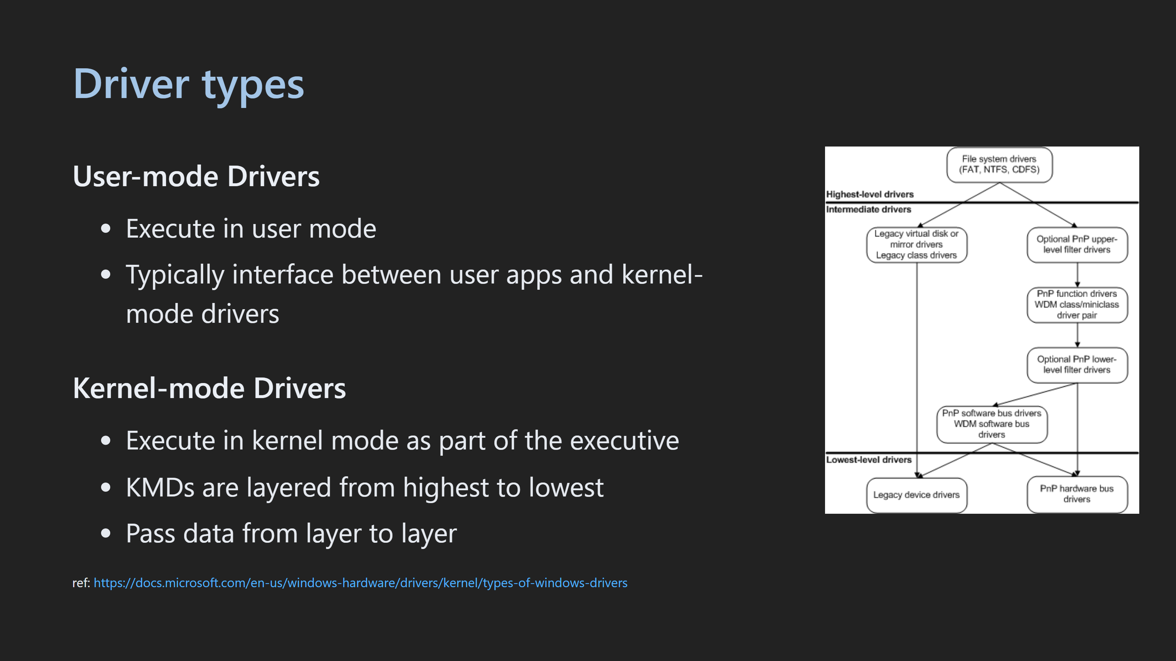

Slide 23
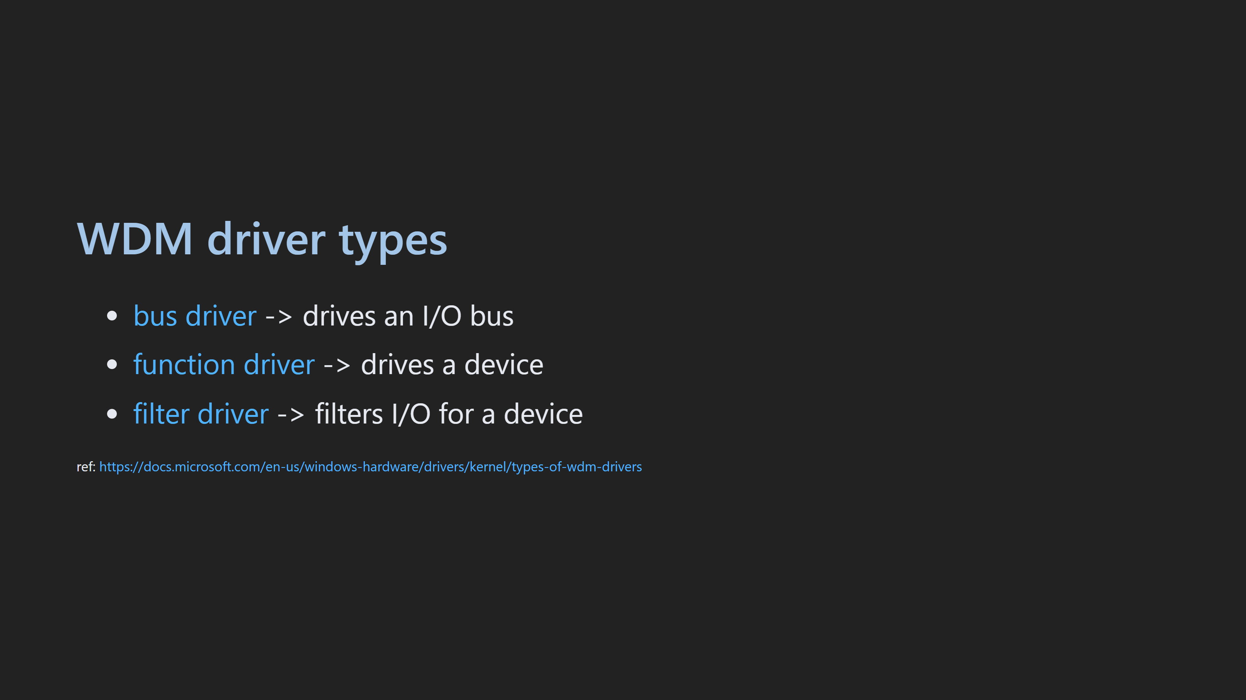

Slide 24
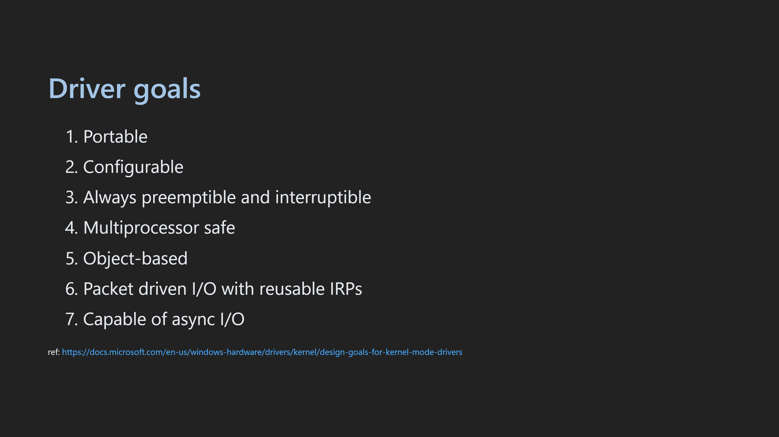

Slide 25
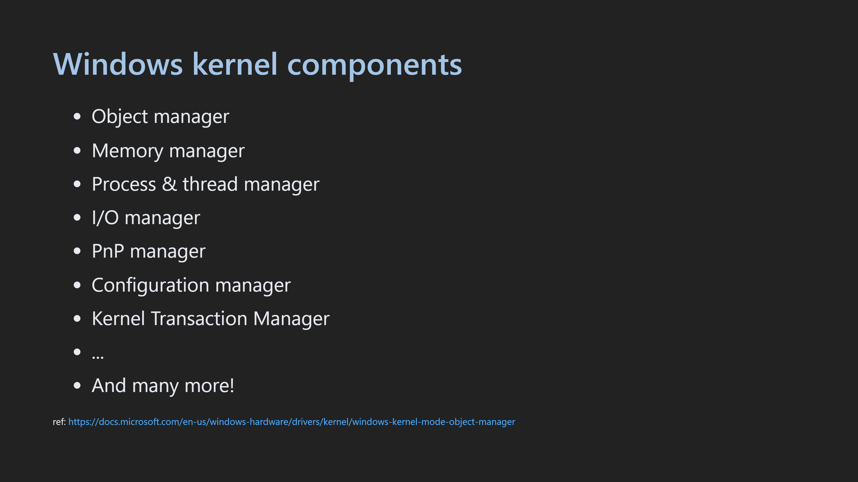

Slide 26
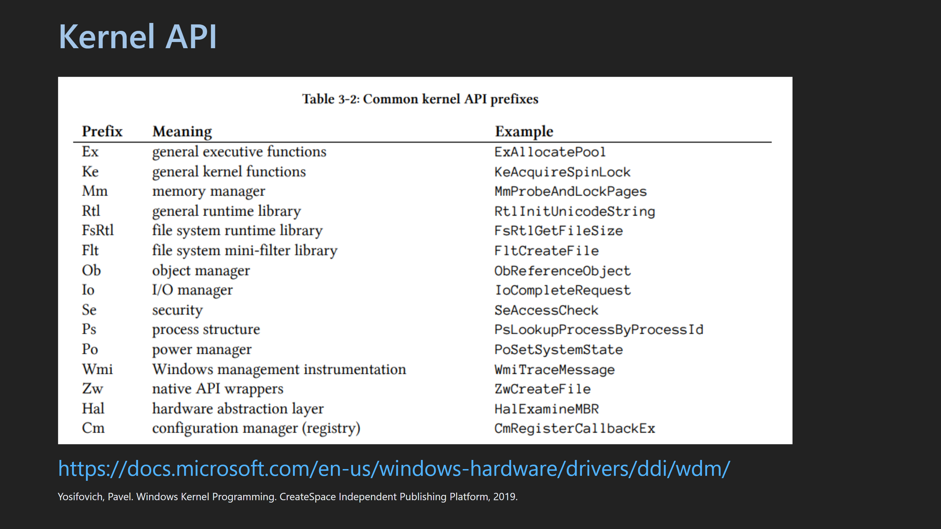
Notes:
- Undocumented API

Slide 27
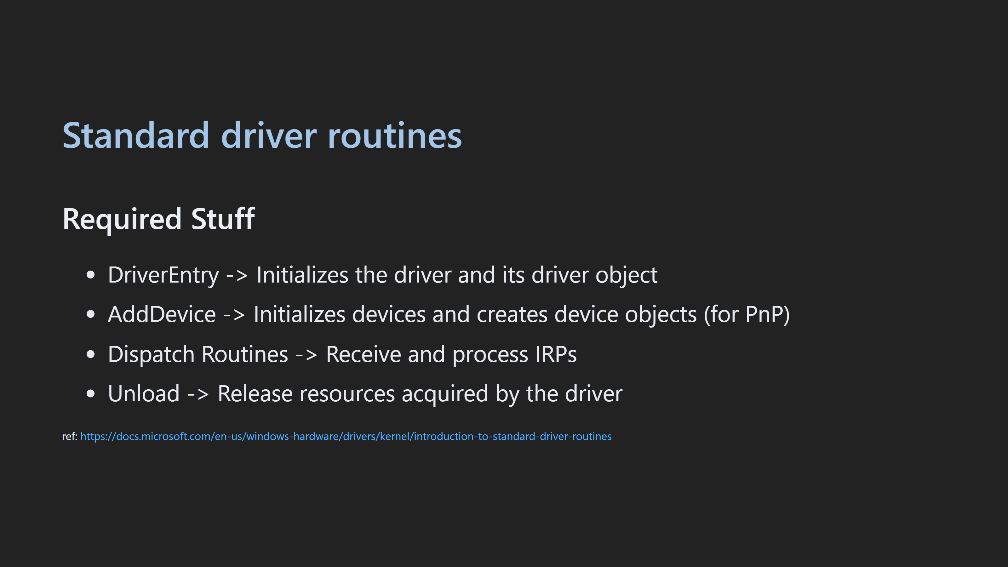

Slide 28

Notes:
- Demonstrate how to copy drivers over - Demonstrate how to create driver service - Demonstrate how to start / stop drivers - Demonstrate how to set breakpoints using __debugbreak()

Slide 29
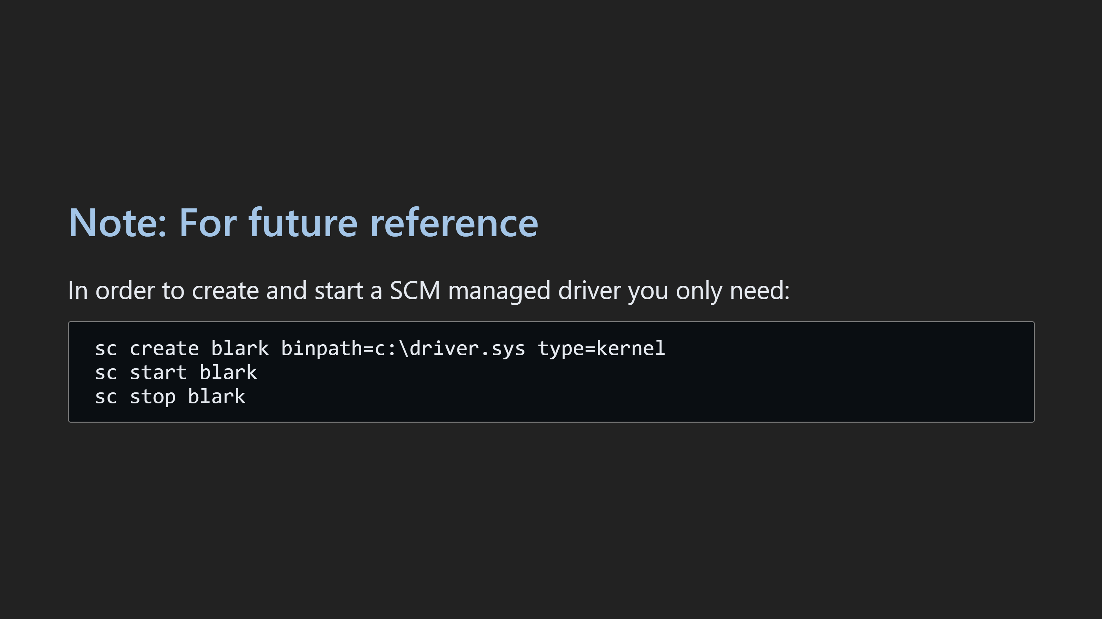

Slide 30


Slide 31
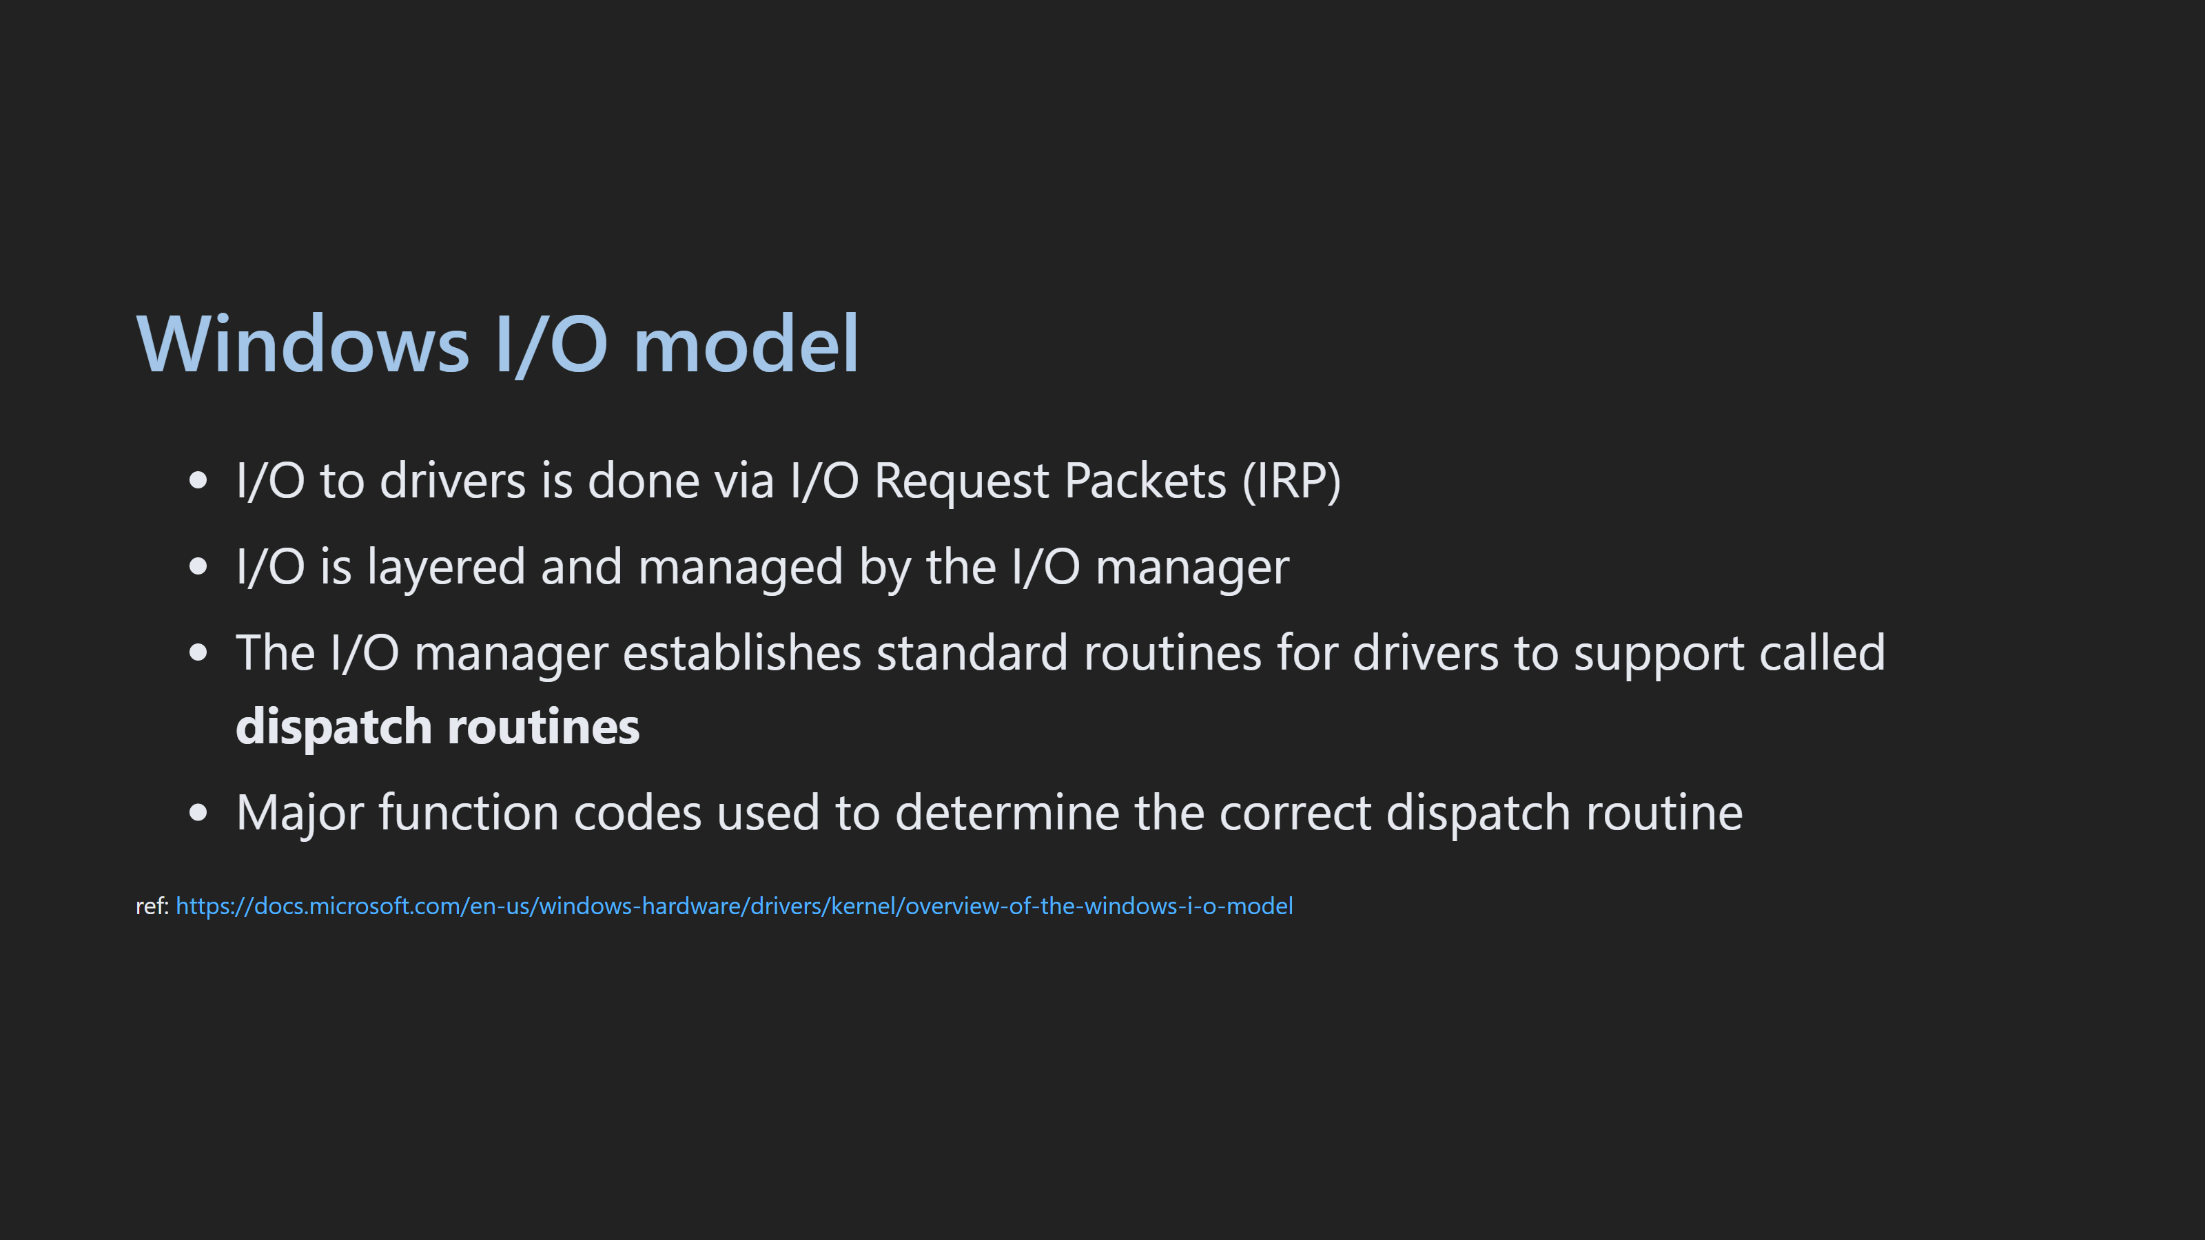

Slide 32
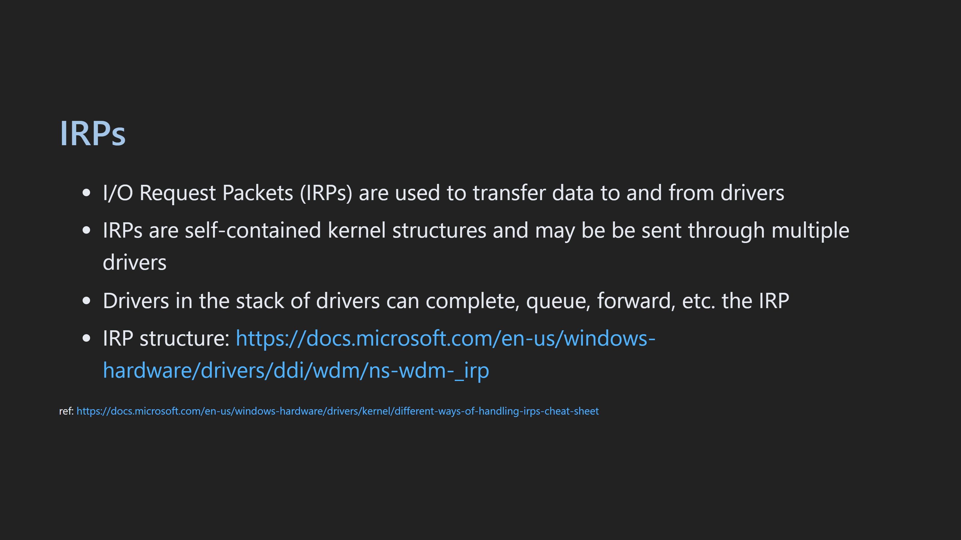
Notes:
- show how to view an IRP in WinDbg

Slide 33
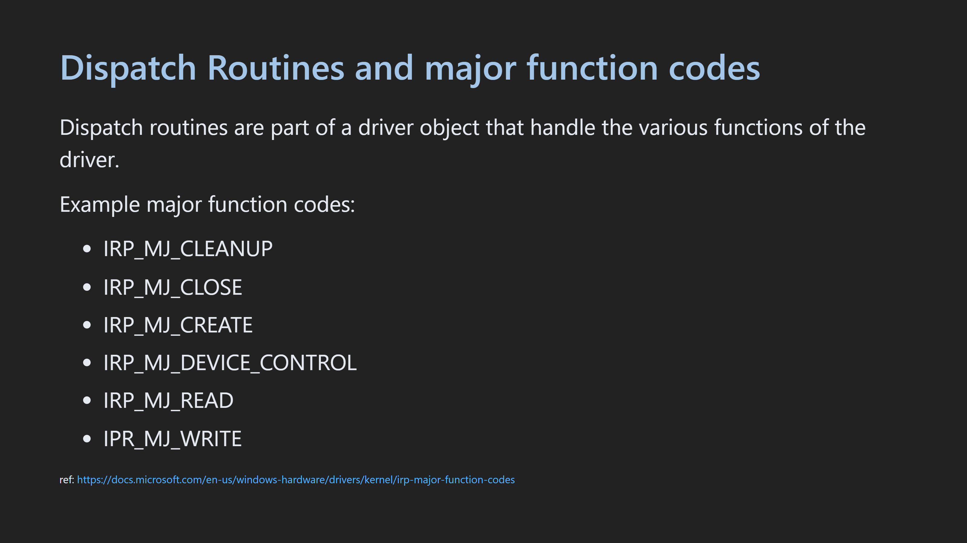

Slide 34
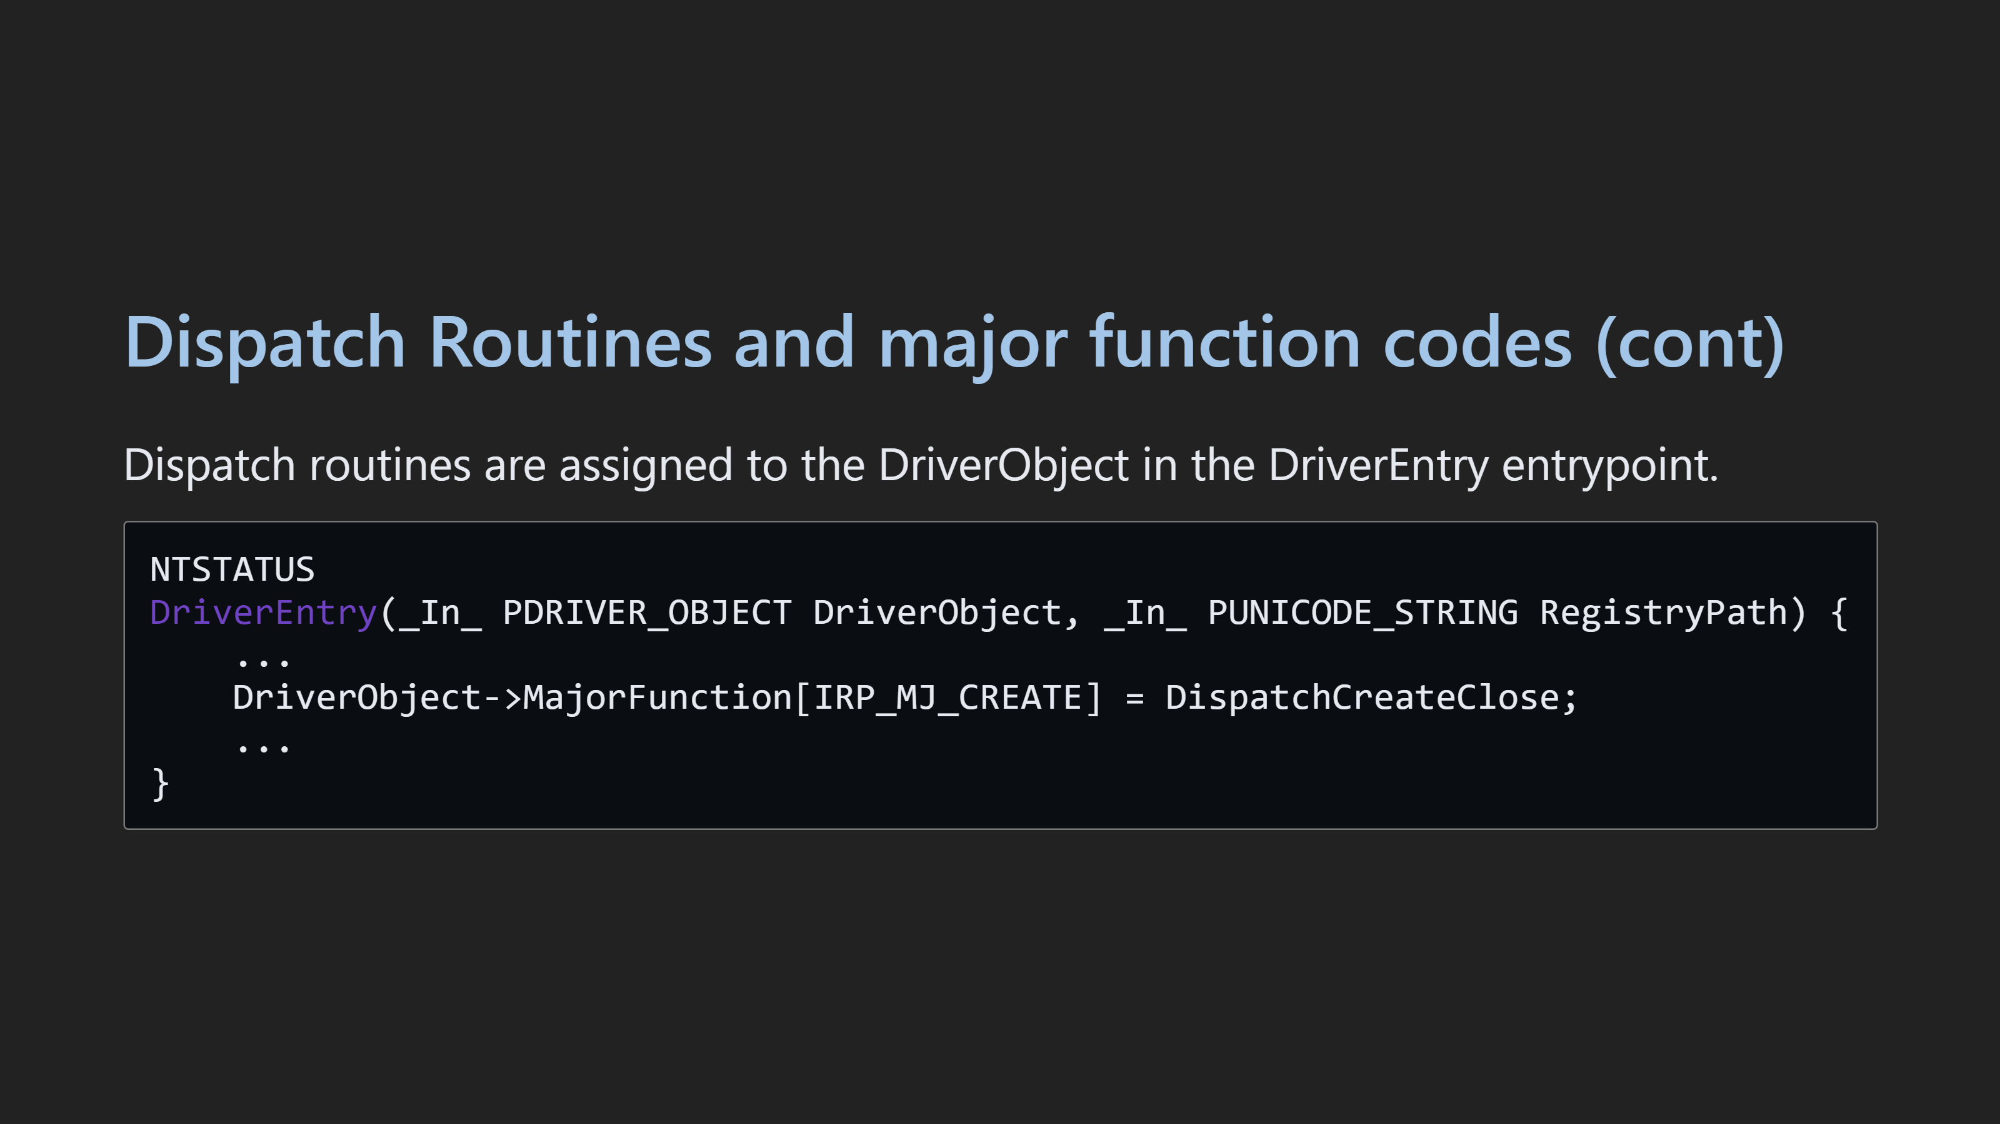

Slide 35
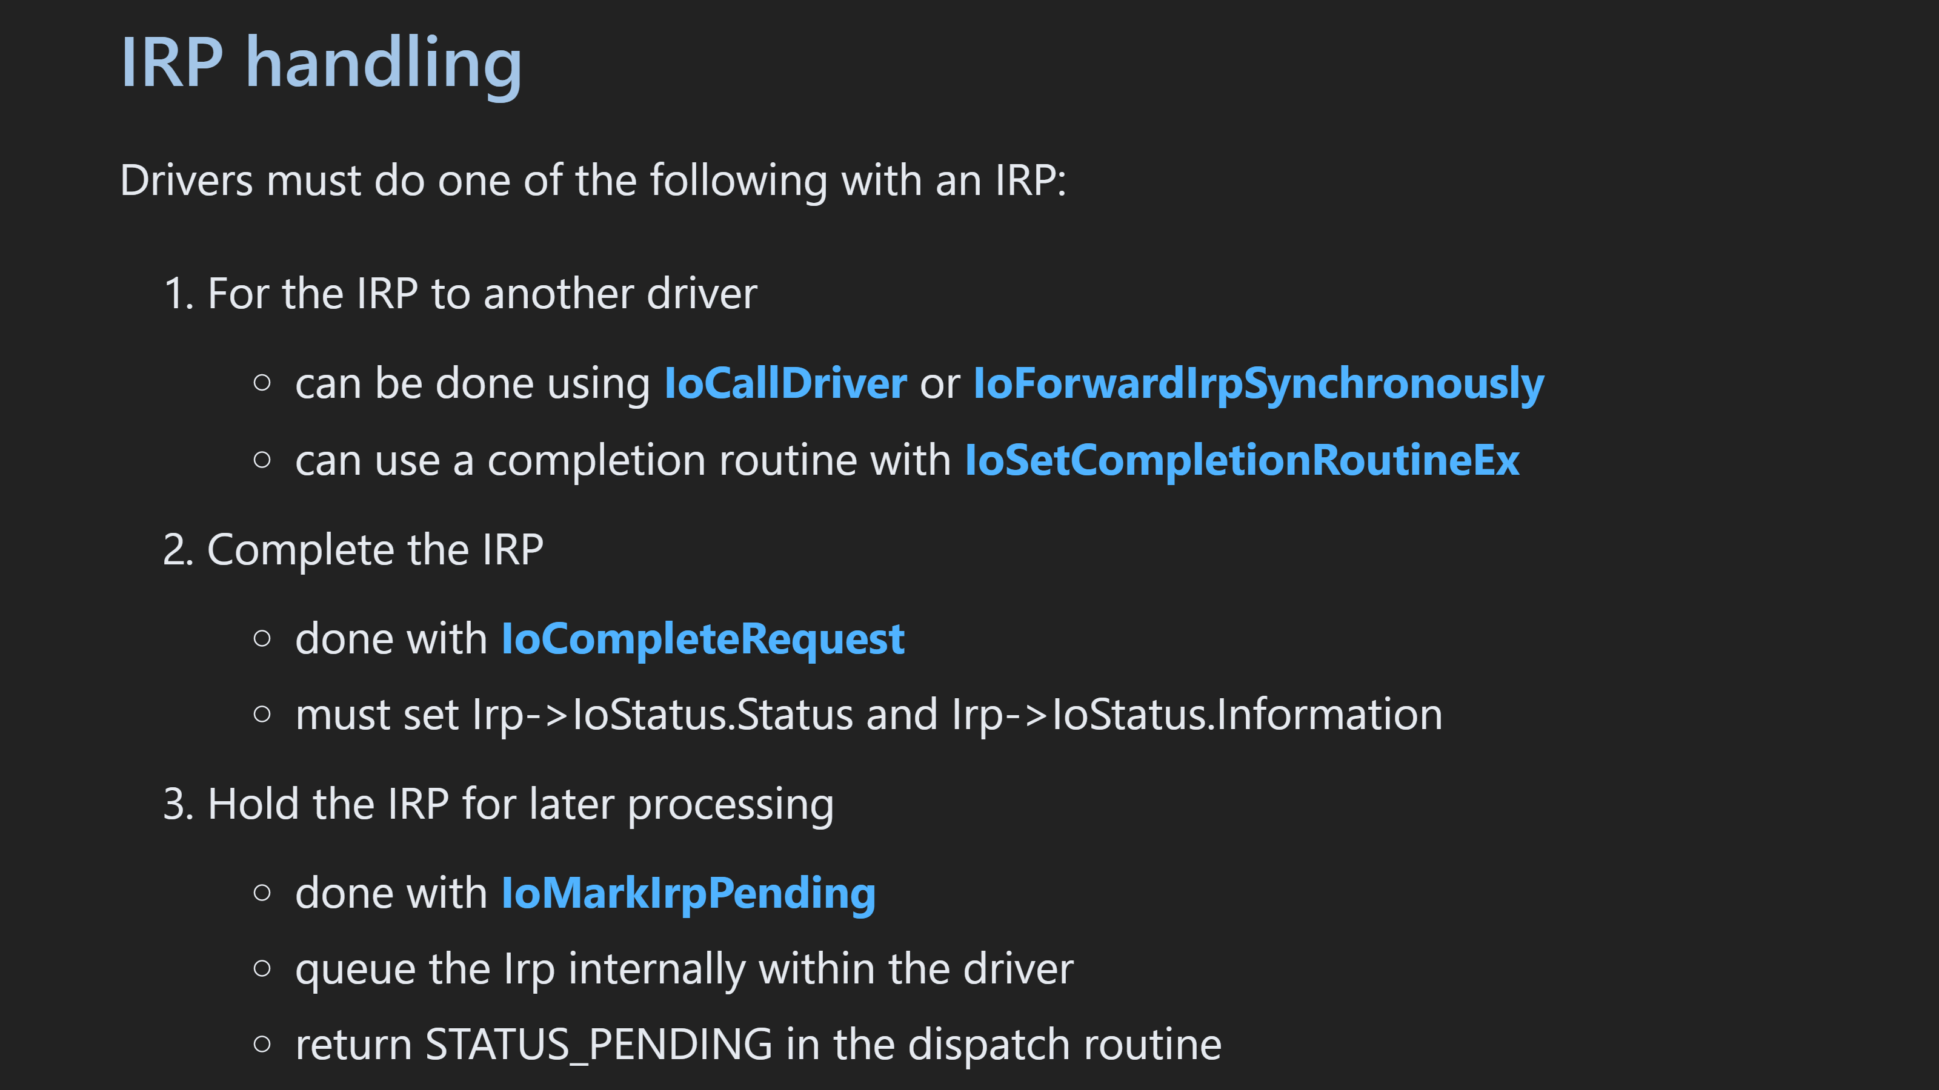

Slide 36
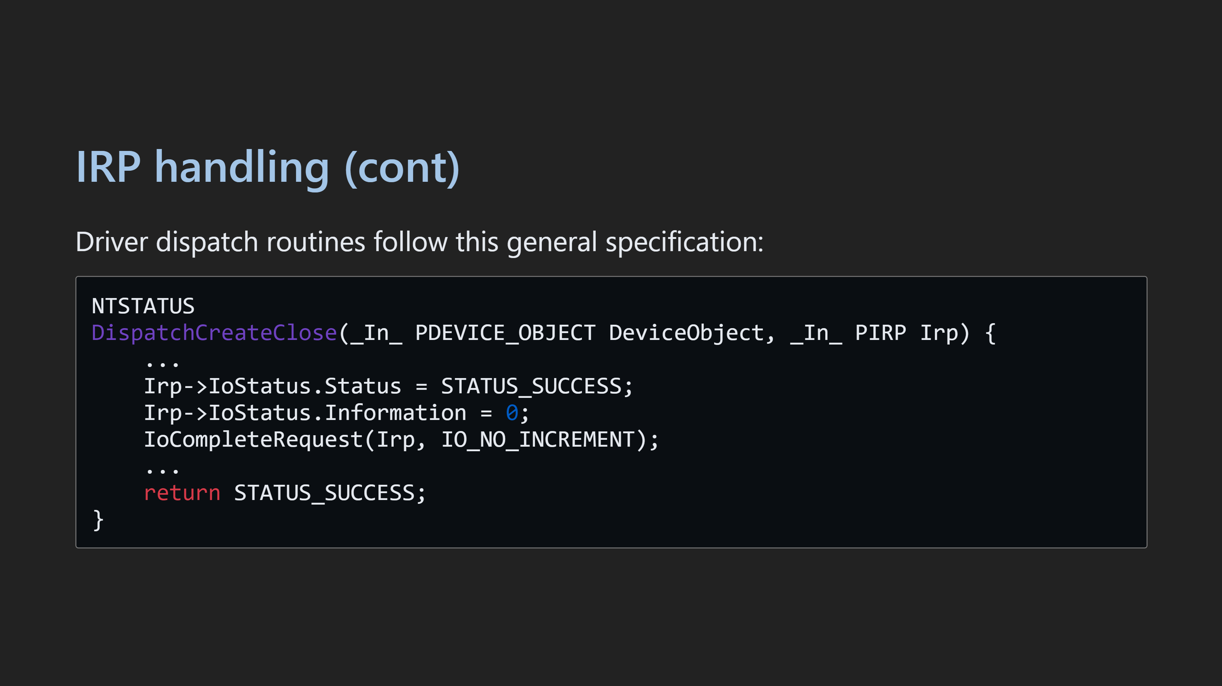

Slide 37


Slide 38
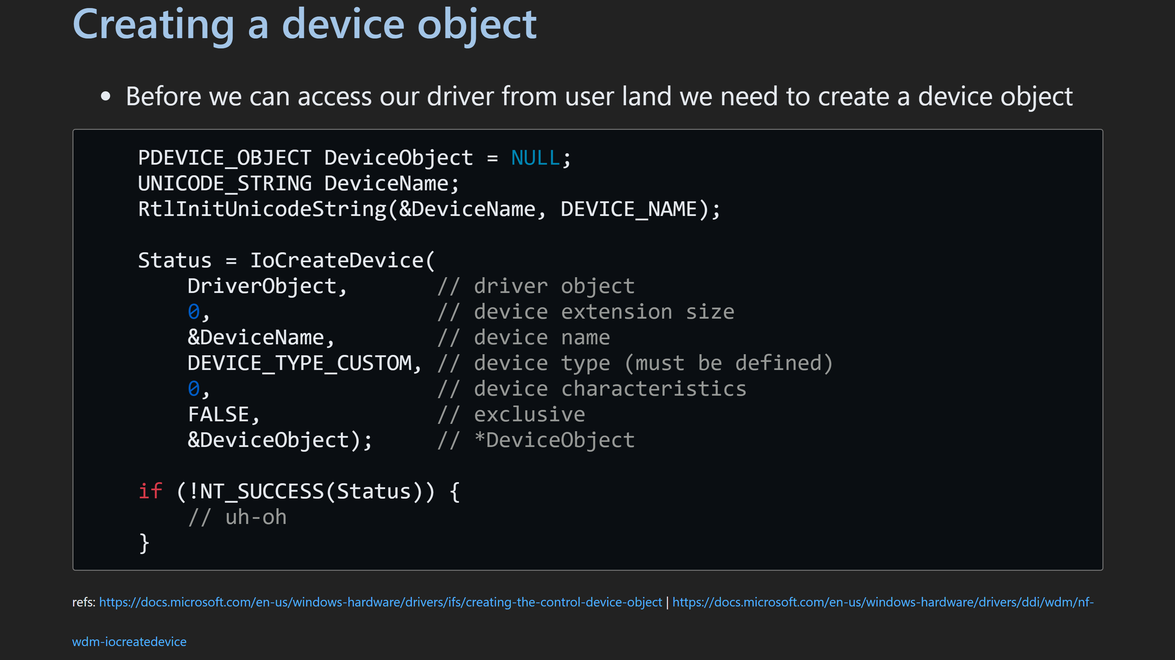

Slide 39
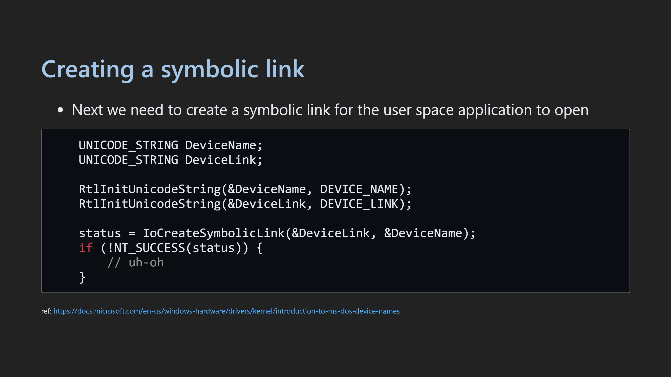

Slide 40
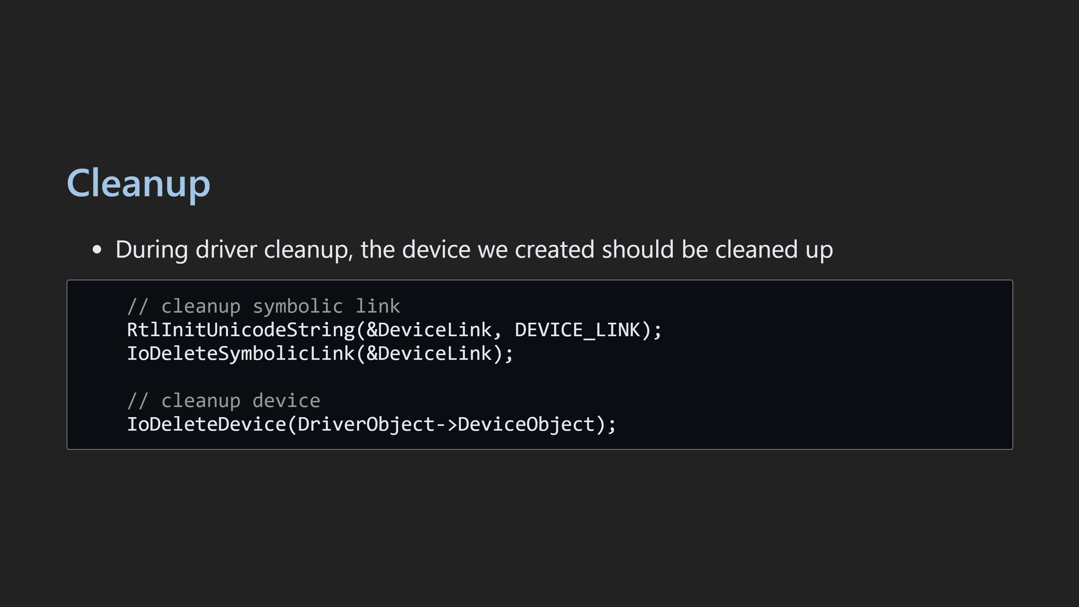

Slide 41
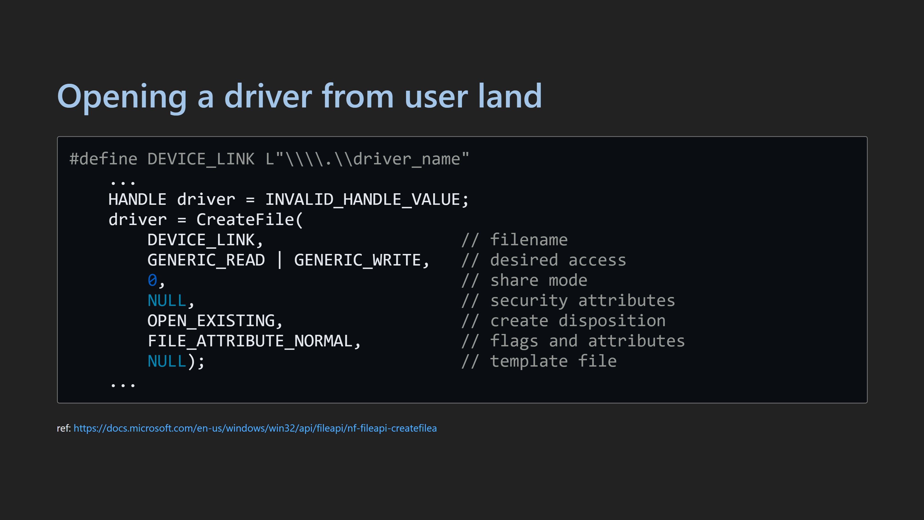

Slide 42
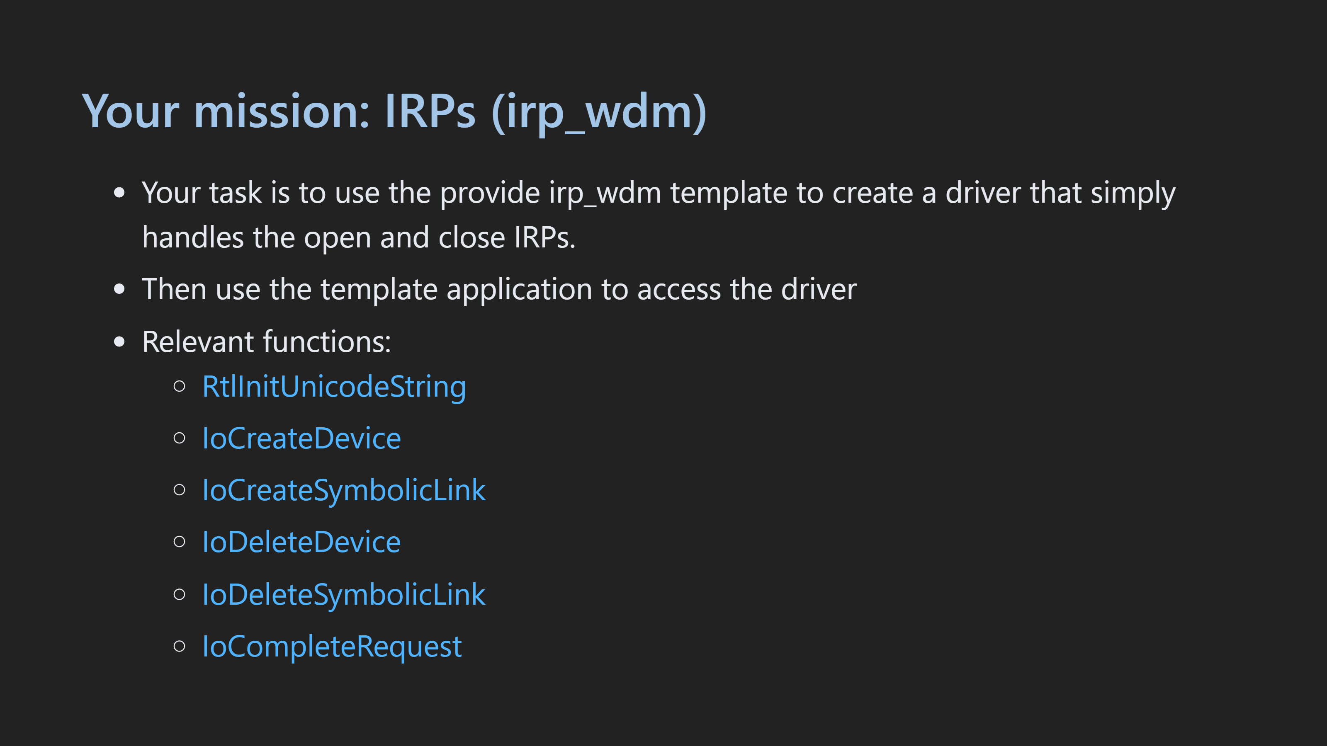

Slide 43

Notes:
- Show device creation in winobj64 - Demonstrate breaking after the dispatch create close - Demonstrate looking at the IRP in WinDbg

Slide 44


Slide 45
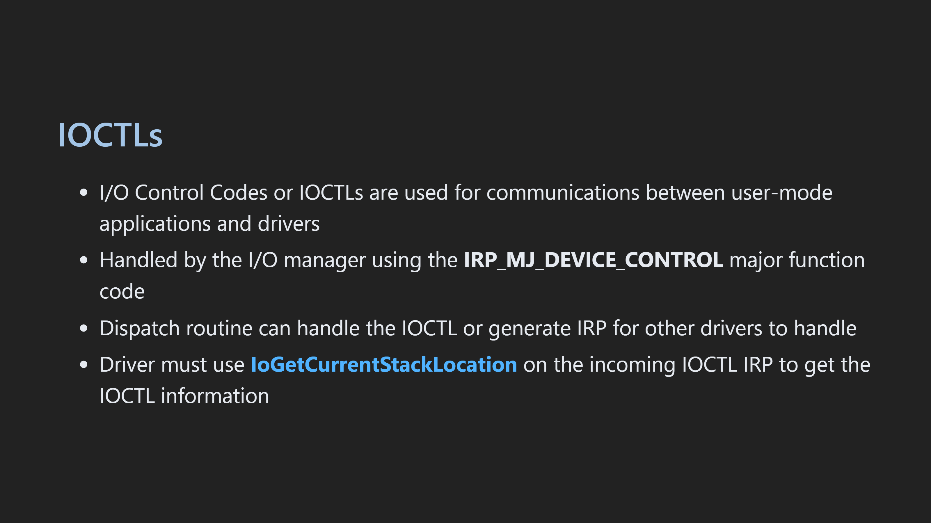

Slide 46
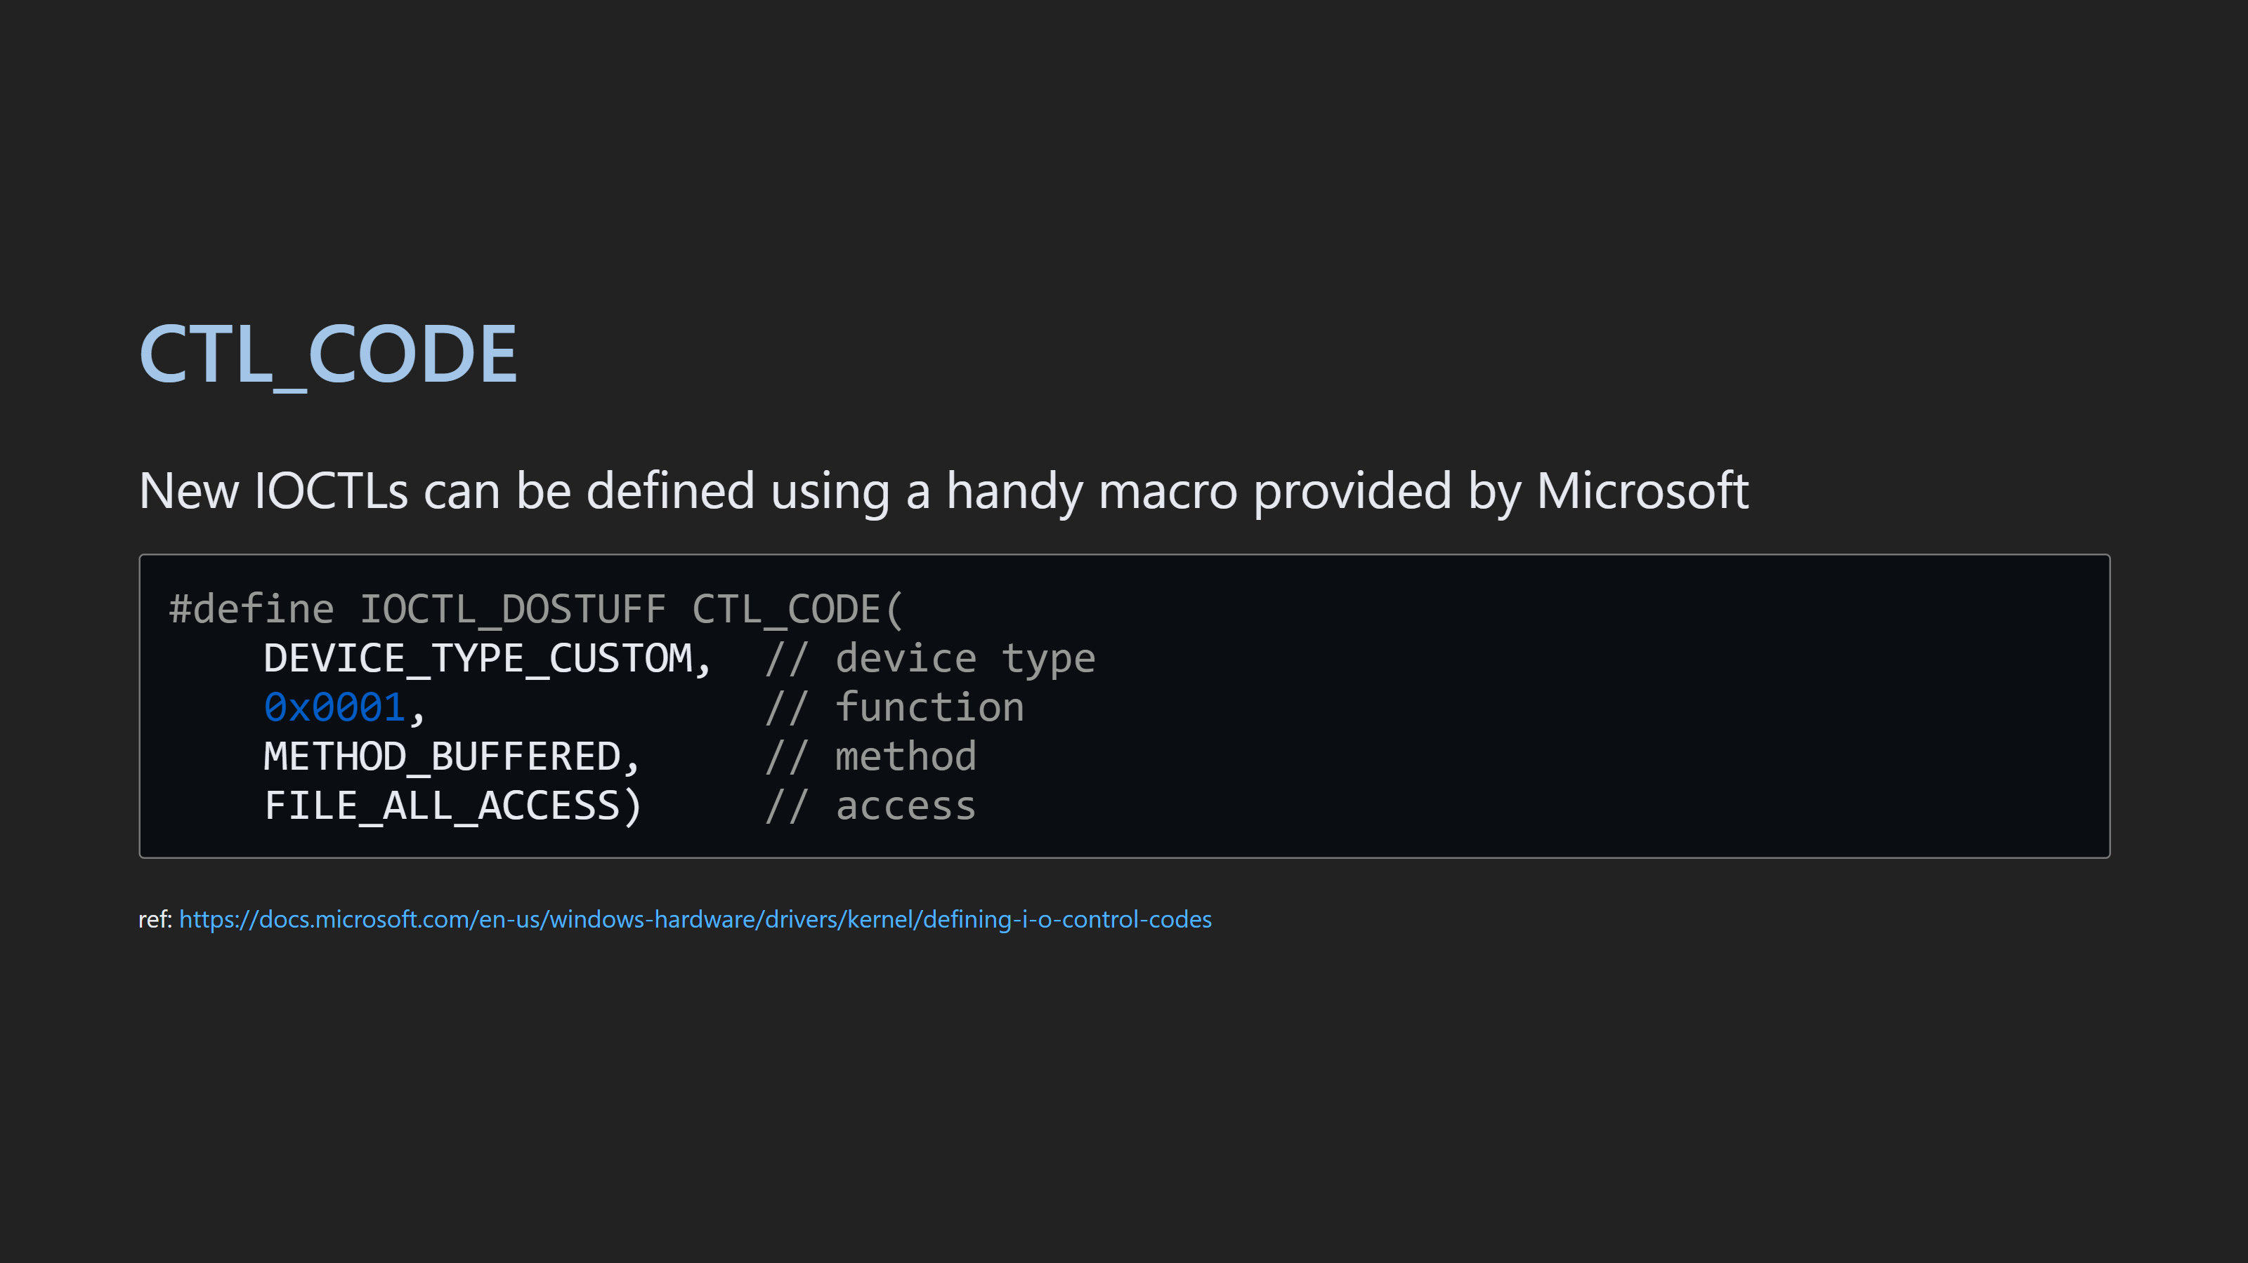
Notes:
- Make sure to show the fact that codes should start at 0x800

Slide 47
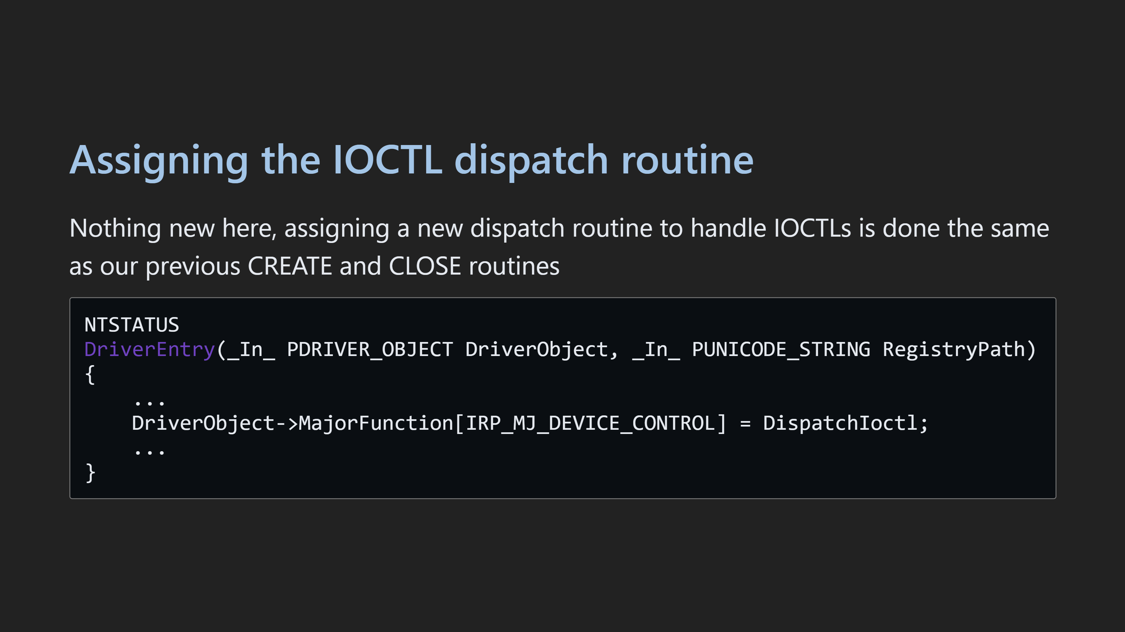

Slide 48
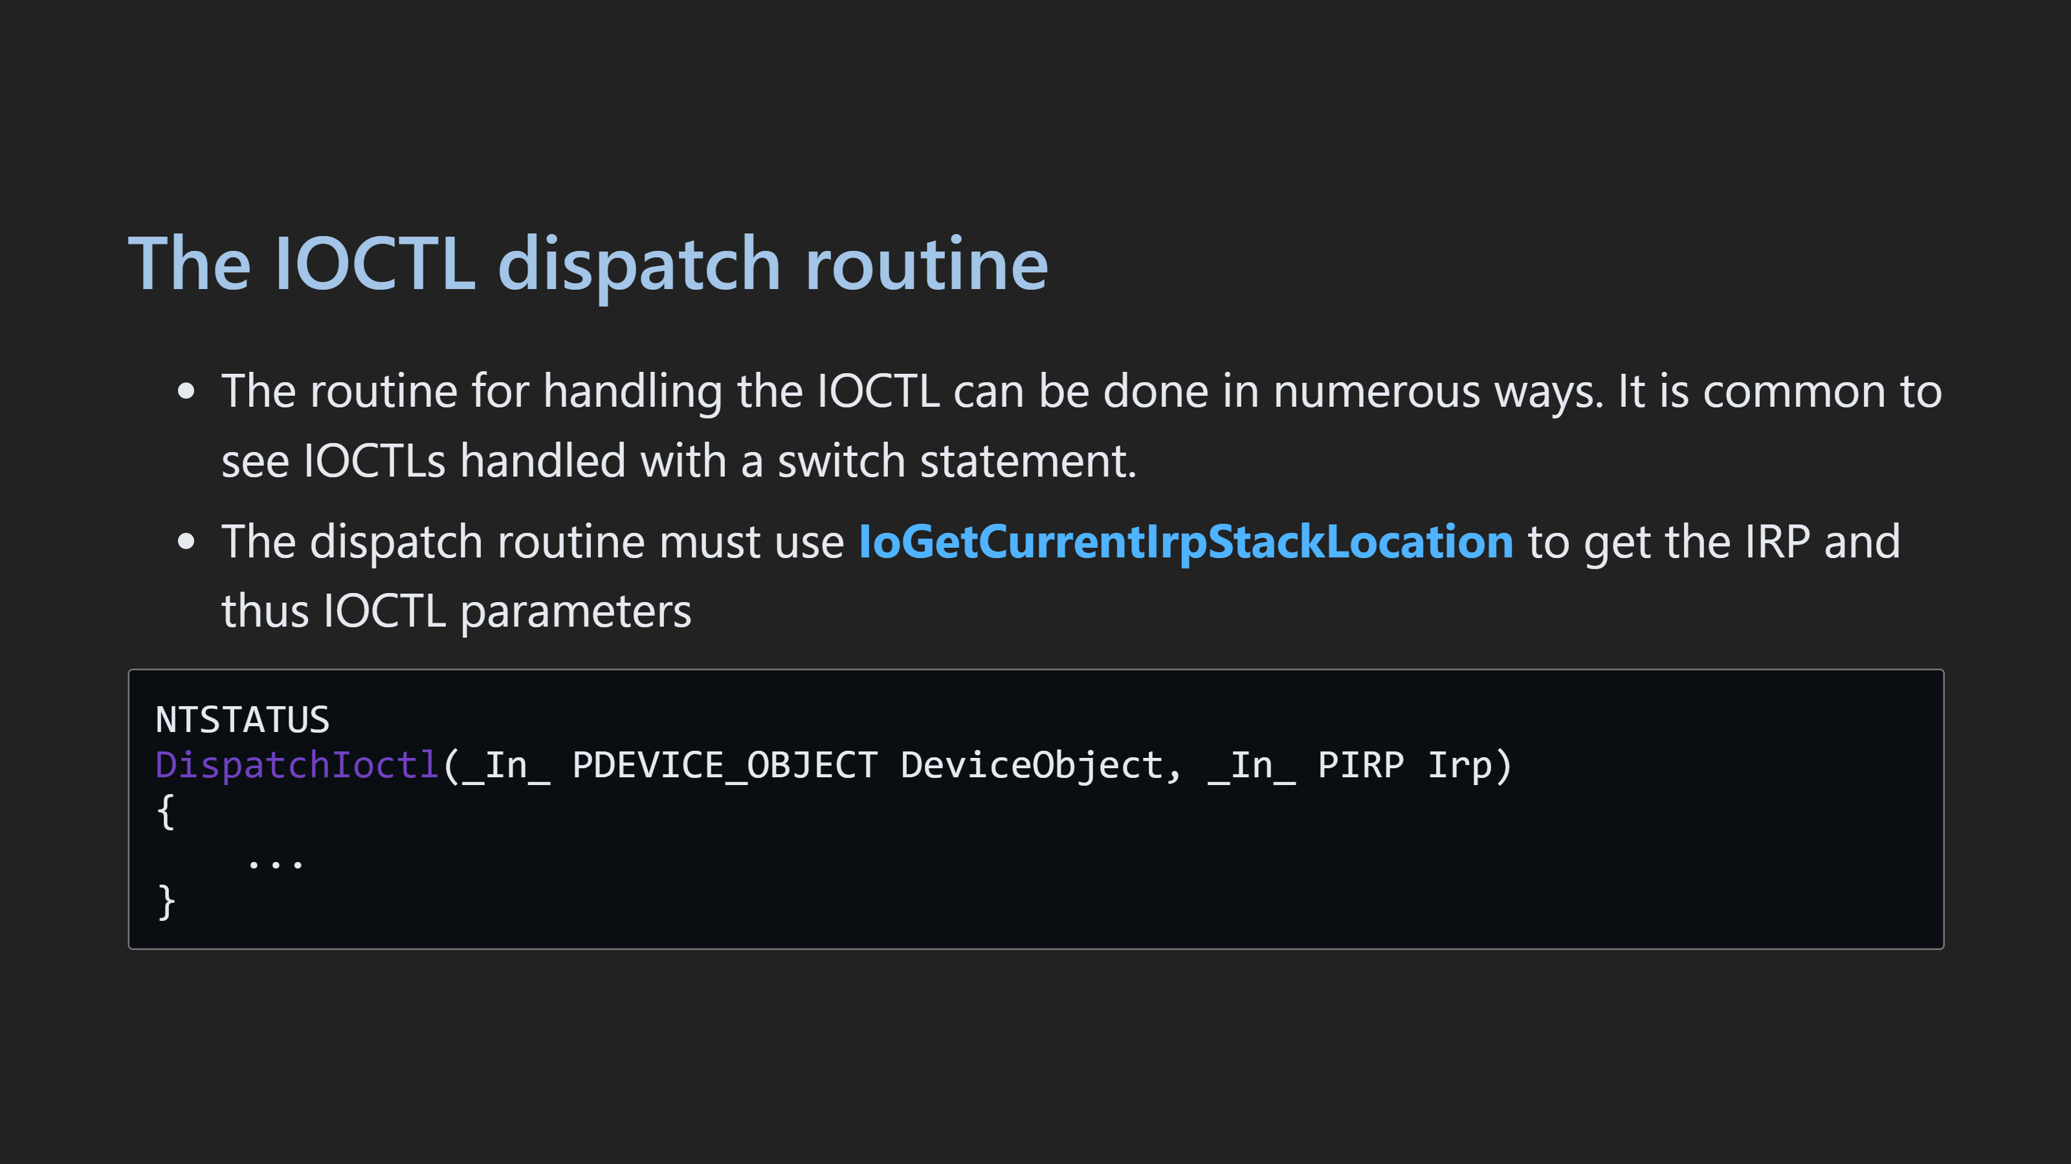

Slide 49
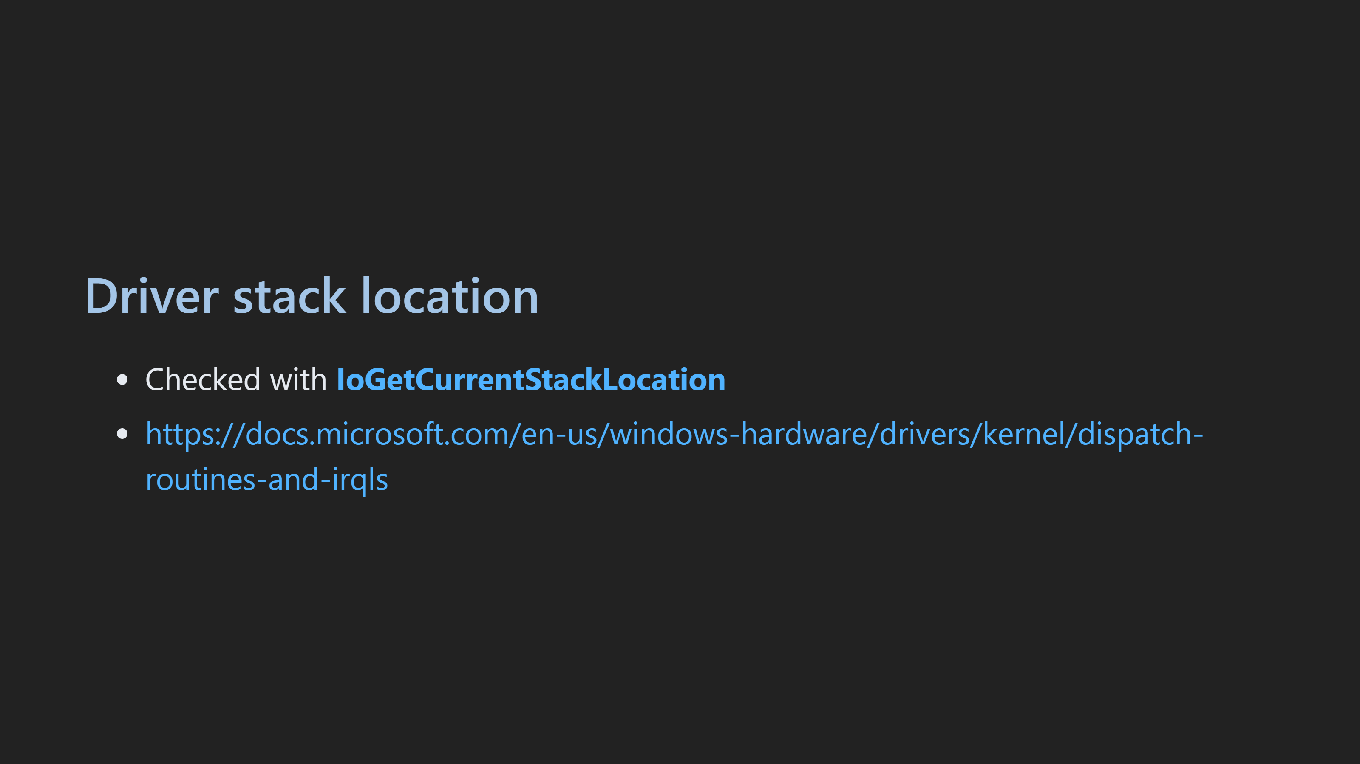

Slide 50
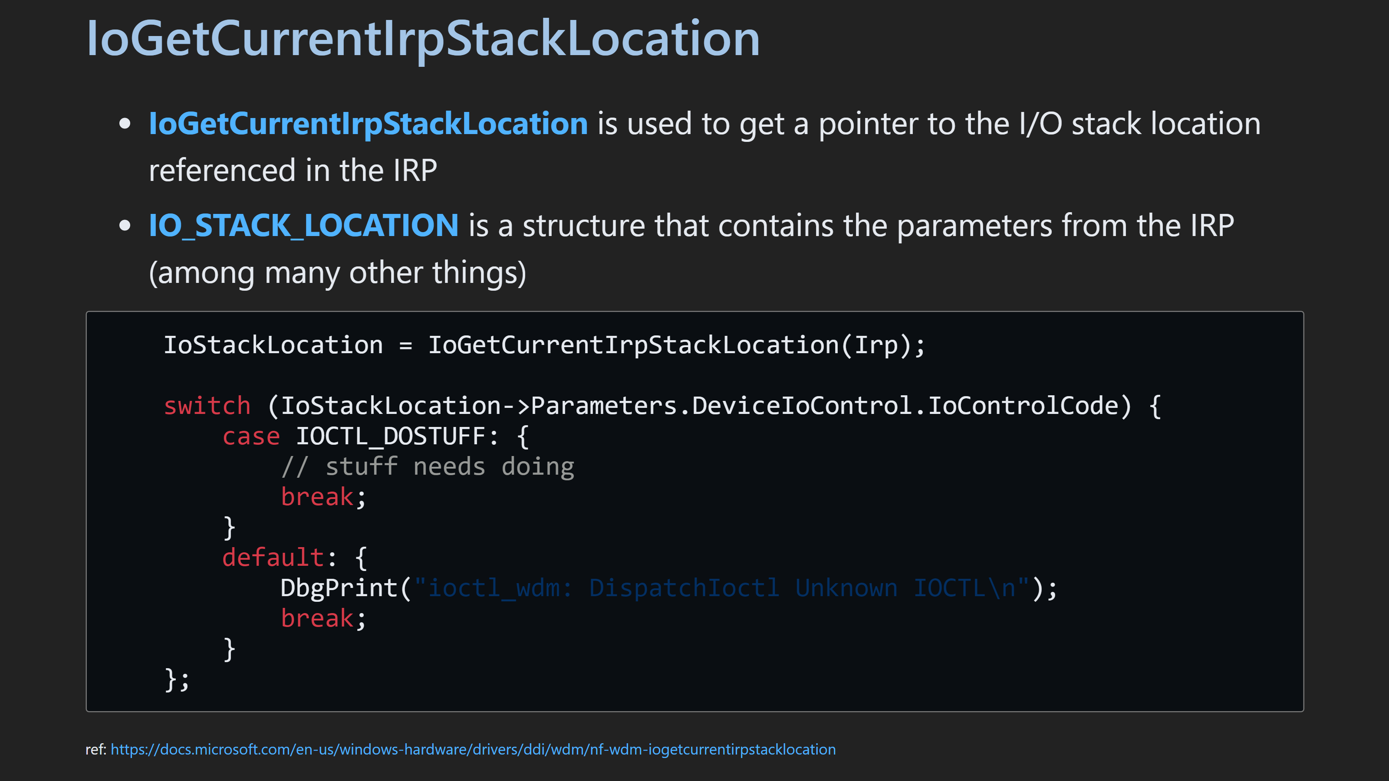

Slide 51
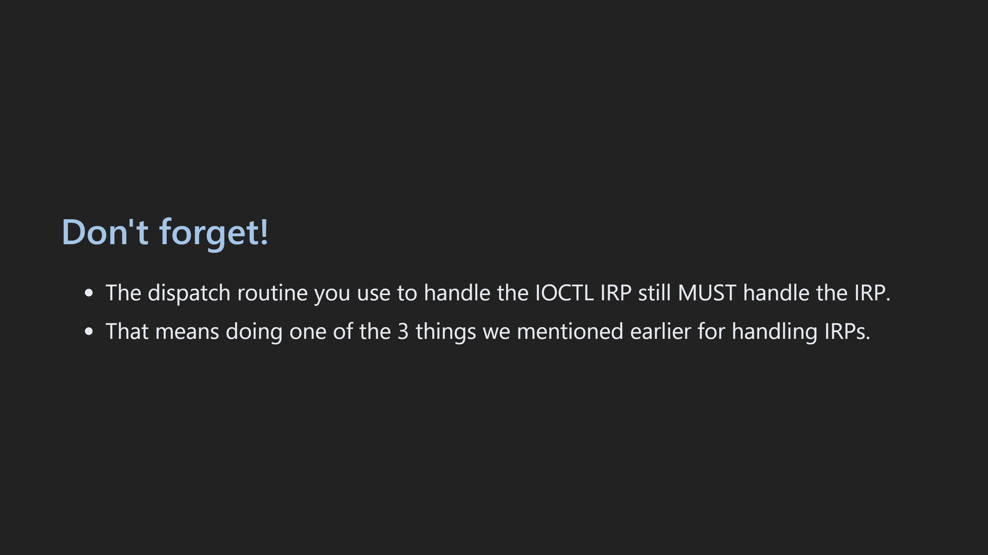

Slide 52
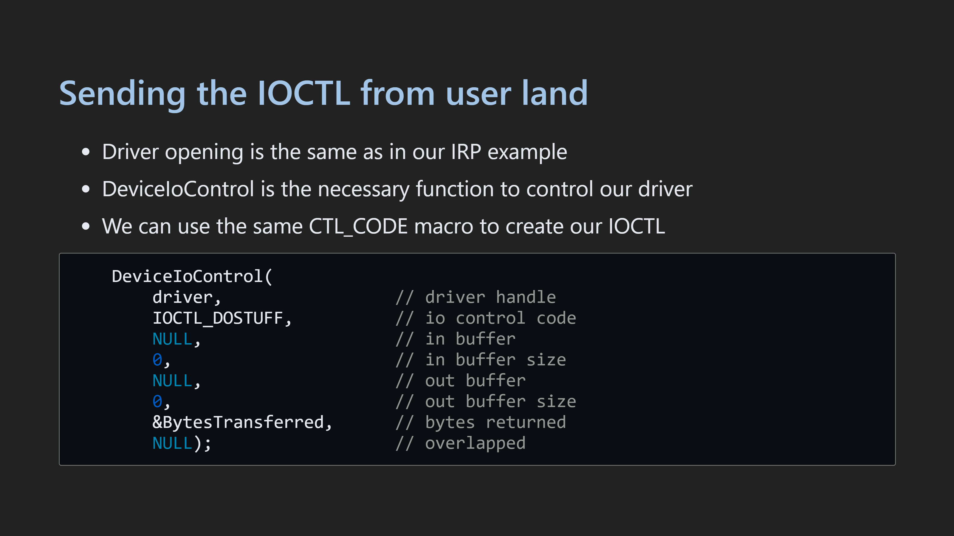

Slide 53
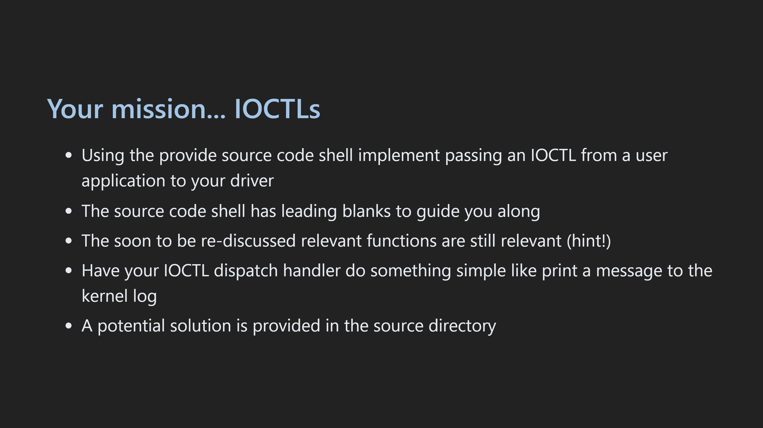

Slide 54
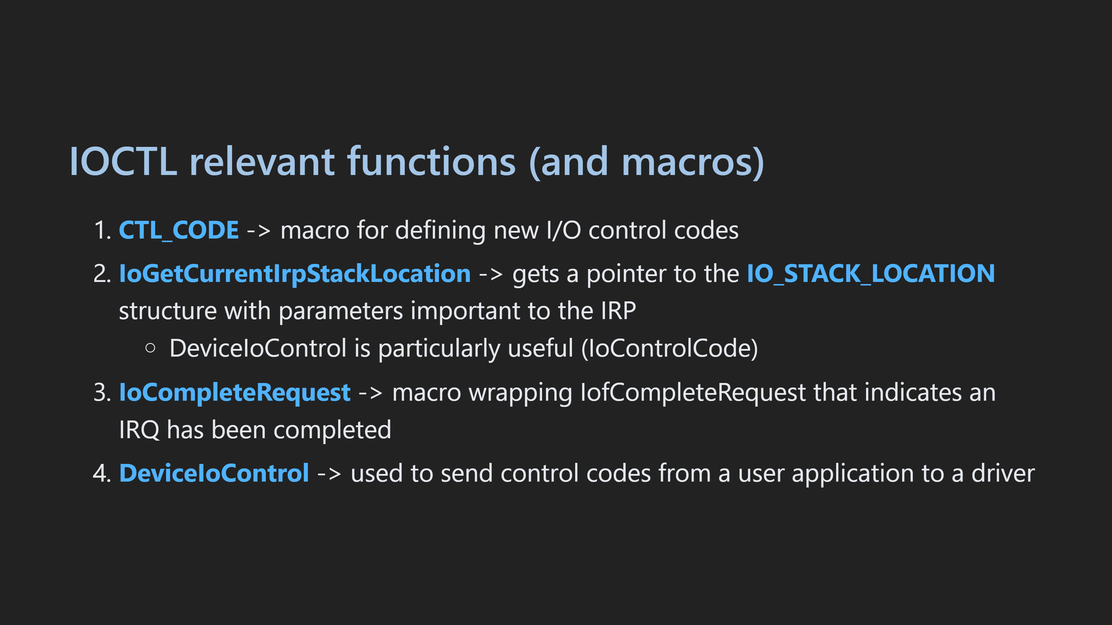
Notes:
- Make sure to show the DeviceIoControl part of IO_STACK_LOCATION!

Slide 55
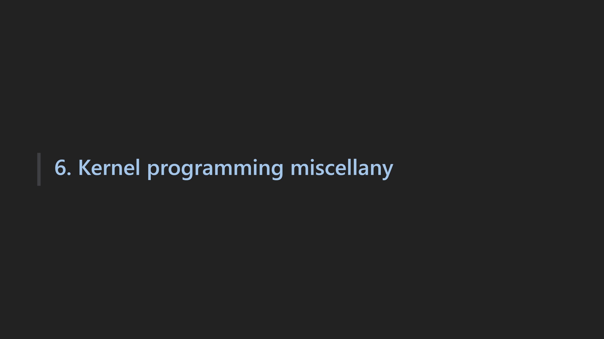

Slide 56
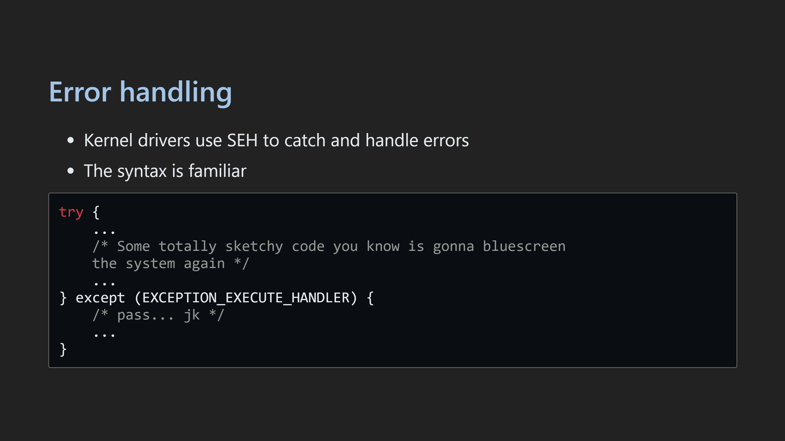

Slide 57
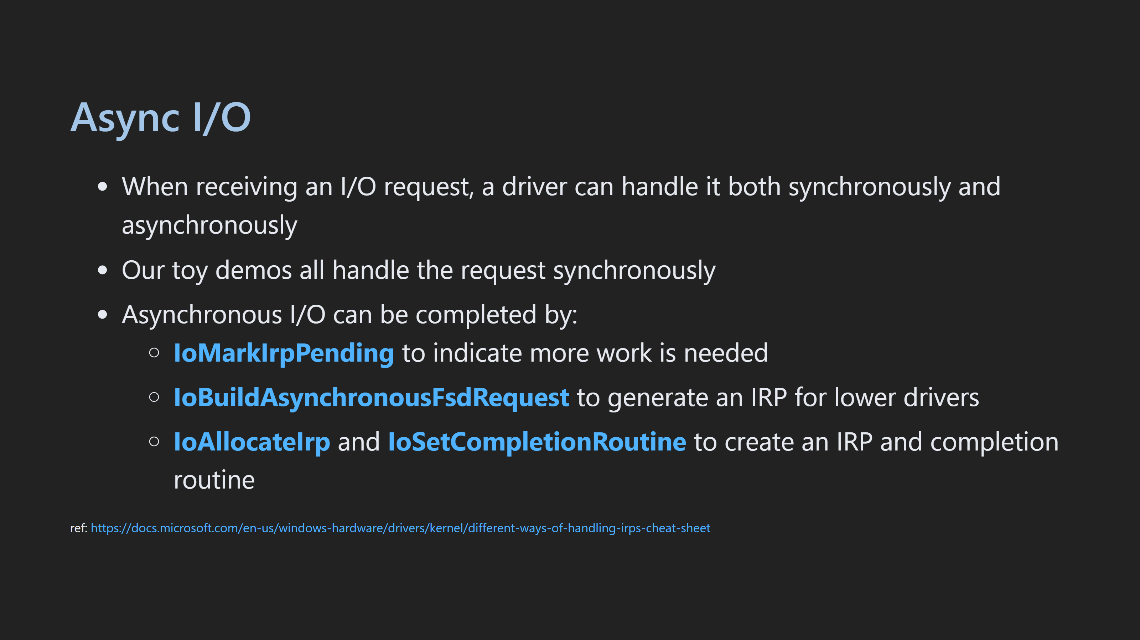

Slide 58


Slide 59


Slide 60


Slide 61


Slide 62


Slide 63

Notes:
!process 0 0 secret.exe dt nt!_EPROCESS <eprocess addr> db ffffc30f05fd7340 + 0x87a L 1 eb ffffc30f05fd7340 + 0x87a 0x61

Slide 64


Slide 65


Slide 66


